Slide 1
Brokerage 101
A partner to your success

Slide 2
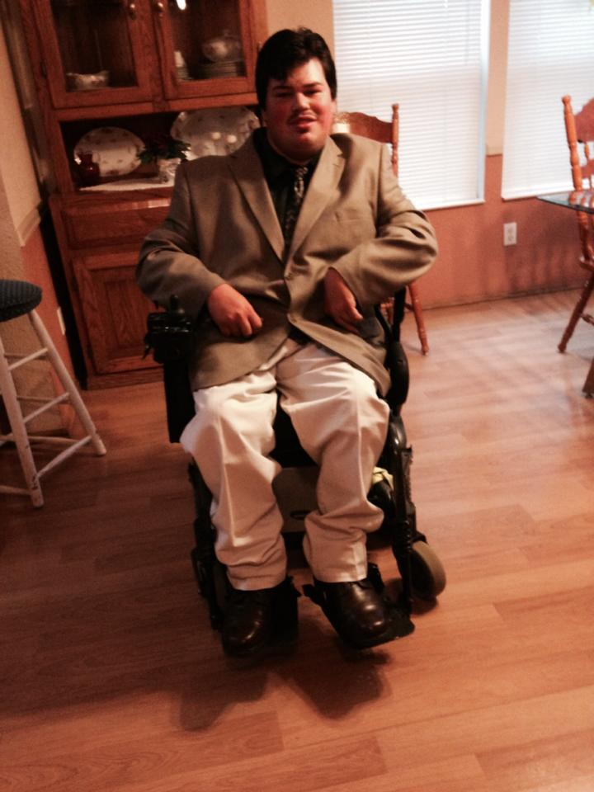
Objectives:
Basic understanding of what Brokerage does
How Brokerage services can help support Transition services
Dispel common misconceptions

Slide 3
There are 3 types of I/DD case management provider options in Oregon:
State case management
State Service Coordinators serve children with I/DD that are enrolled in the Children’s Intensive In-Home Services program.
Community Developmental Disability Program (CDDP, often counties) case management
CDDP Service Coordinators serve children and adults in a wide range of services: Group Homes, Foster Care, In-Home, and more.
Brokerage case management
Brokerage Personal Agents are designed to serve a very targeted segment of the population: adults with I/DD choosing to live in their own or in their family homes.

Slide 4
What is a Brokerage?
Support Services Brokerages are private organizations that provide case management for in-home and community-based services to adult Oregonians with Intellectual and Developmental Disabilities.
Brokerages presently support nearly 8,000 people with I/DD living independently in the community.
No matter where someone lives in Oregon, there is a Support Services Brokerage available. In some areas, there are as many as five choices!
All brokerages are governed by boards/advisory. Most boards are comprised of community members, individuals who experience I/DD and their families.

Slide 5
How Brokerages came to be

Slide 6
For decades, adult Oregonians with developmental disabilities could only receive long term care services in an institutional setting, such as the Fairview Training Center.
People who requested community-based services were on wait lists for years, and most were never even transferred to community-based care. At the start of the 2000s, over 5,000 people were on waitlists for case management services. Individuals with I/DD and their families began to advocate for the right to receive services in their communities in noninstitutionalized settings.
In 2000, 5 individuals with I/DD sued the state for the right to receive community-based services. The class action lawsuit Staley v. Kitzhaber was settled in 2001. The result of the lawsuit was Oregon made a commitment to serve people with I/DD where they are already living. Rather than forcing people to choose institutions, Oregon made the commitment to close them, and restructured services to expand home and community-based supports dramatically.
The Staley settlement increased the availability of comprehensive residential services, established the statewide brokerage service system, and ultimately eliminated the wait list for community-based services. Oregon agreed to begin providing home and community based supports to everyone who qualifies for services. Soon thereafter, local Support Services Brokerages formed and by 2001, brokerage services began being offered throughout the state.
In 2009, Oregon closed its last institution for people with developmental disabilities.

Slide 7
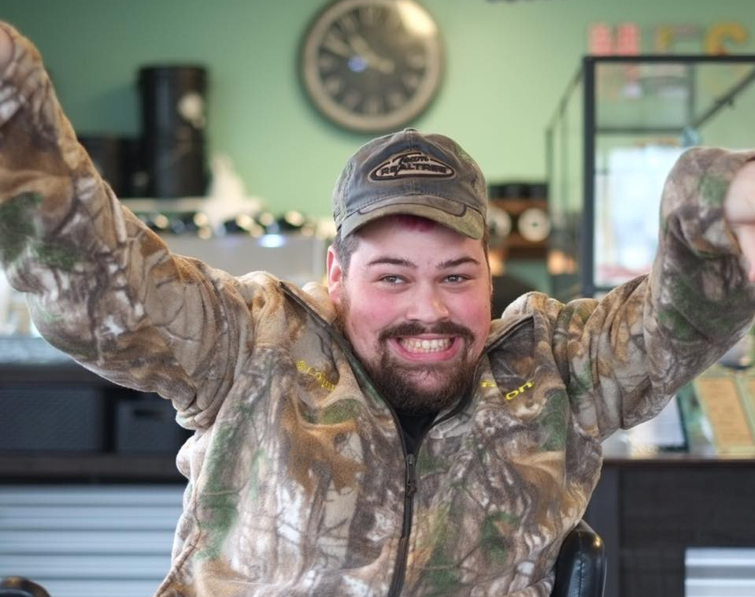
Today, Brokerages serve nearly 8,000 individuals across Oregon via 14 organizations!

Slide 8
Accessing Adult Developmental Disability services:
Contact the local community developmental disability program (CDDP) to find out if the individual is eligible for services
An eligibility worker will help complete the application and collect any needed documents
The eligibility worker will use the completed application and other documents to determine if the individual is eligible for services
Within 10 days of submitting the completed application the individual is notified by the CDDP of their eligibility

Slide 9
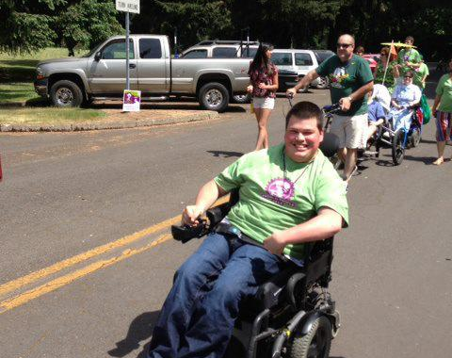
Eligibility for brokerage services
Individual must be found eligible through their County Development Disability Services program.
Individual must be 18 years of age or older.
Brokerages serve individuals living independently in the community, or in their family homes.

Slide 10
Already connected to disability services?
At age 18 Choice Counseling with CDDP should occur. The case manager will discuss what type of case management services best fit the individuals needs and wants.
When it is determined that an individual qualifies for and wants brokerage services the case manager then sends a referral to the individuals chosen brokerage or brokerages
It is an option for the individual to interview representatives from the brokerage options before making a final choice

Slide 11
What is a Brokerage Personal Agent?
Brokerages have Personal Agents (PAs) rather than “case managers” of CDDP. PA does not stand for “Personal Assistant”.
Personal Agents meet with clients to assess their needs, connect them with support providers and refer them to services.
The Personal Agent assess an individuals support needs through the Adult Needs Assessment and Risk Identification Tool.
Personal Agents write the Individual Service Plan (ISP). Personal Agents monitor and update the ISP as needed throughout the plan year.
Personal Agents help negotiate contracts with Personal Support Workers (PSW) and agencies so that individuals can access the support services they want and need.
Personal Agents maintain regular contacts with client to ensure support needs are being met and connect clients with services for any unmet needs.
Personal Agents do not provide personal supports for individuals such as taking them to doctors or assistance with grocery shopping.

Slide 12
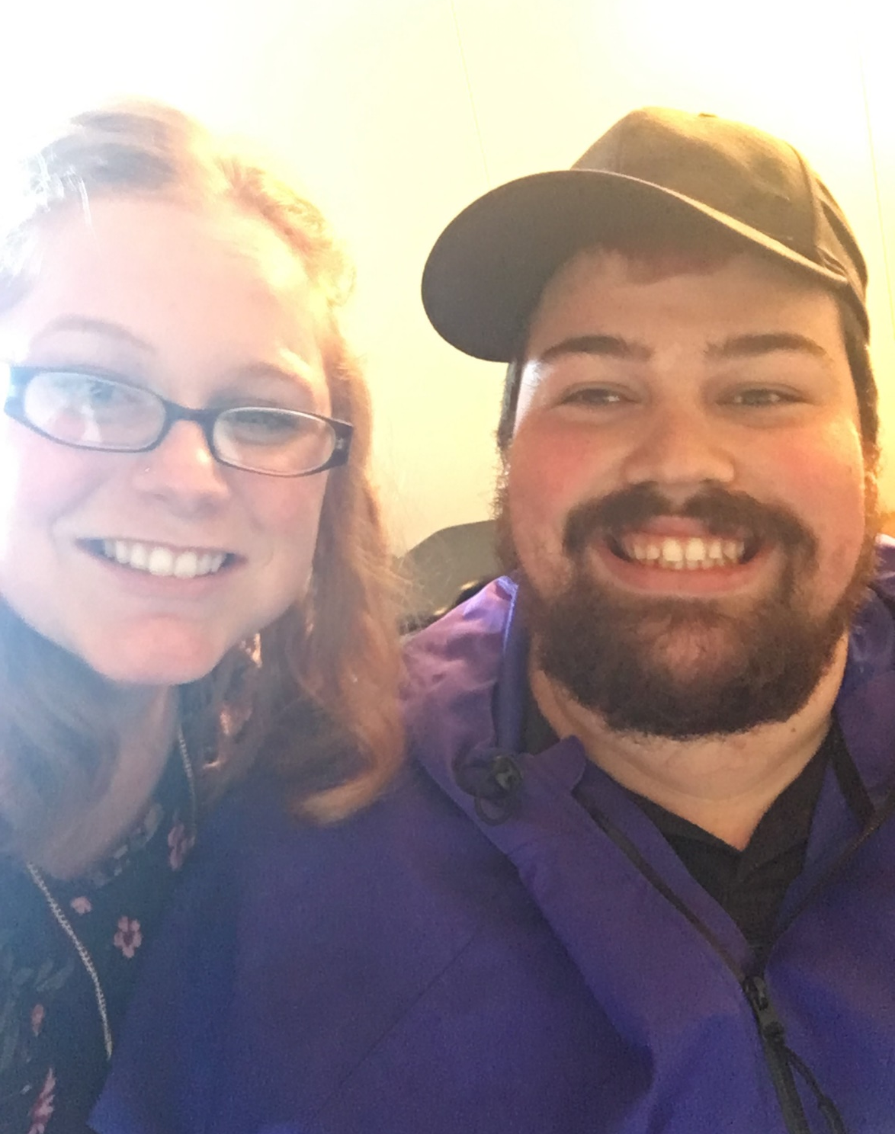
Nick’s Personal Agent
While Nick was in his transitions program he found that having a transitions teacher and a Personal Agent helped him feel like he had the freedom to work on his goals independently, but also the support he needed to accomplish them.
It’s nice to know that if something changes in my life, I can call my Personal Agent and discuss what I want and need. Sometimes it nice just to have someone to listen and help me if I need it.

Slide 13
The Individual Support Plan (ISP)
The ISP is a document that explains an individual’s needs, goals, available supports and chosen services.
The ISP is based on the following documents:
Adult Needs Assessment(ANA)
Risk Identification Tool
Person Centered Information
Once an ISP is signed, it authorizes all the services an individual will receive for the next plan year.
The ISP contains both waiver and K plan services.

Slide 14
The Community First Choice Plan (K plan)
The K Plan provides personal care and other services in home and community based settings.
In order to be eligible to receive Community First Choice (K plan) services they must:
Have OHP Plus (Title XIX Medicaid)
Meet the ICF/IDD Level of Care
Have an assessed need for the service
Have an ISP in place authorizing the chosen service

Slide 15
“Not just a bus pass” guide to what we do (K plan services while in YTP)
Assistive devices
Assistive Technology
Bus Pass and other community transportation that meets student’s needs beyond the LTD bus fare
Behavior support specialist who works in conjunction with school psychologist to implement a positive behavior support plan that extends beyond school doors.
Personal Support Workers (Attendant Care)
Community Nurse Services
Environmental Modifications
Relief Care
Skill Training that supplements and builds upon school program

Slide 16
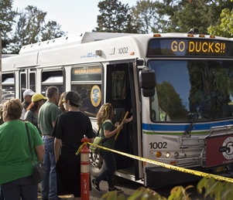
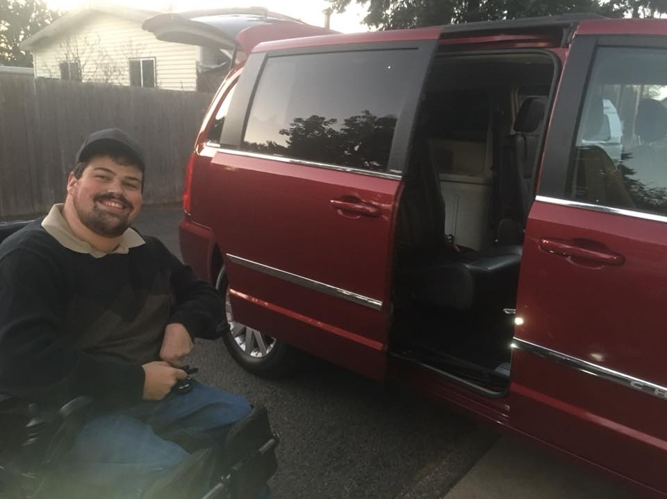
Community Transportation
Nick Has his own vehicle that with the assistance of family & friends who can drive he can get around town.
Thanks to his support services through Full Access, Nick also receives a bus pass which he uses on a daily basis to get to work and other places in the community, His supports through Full Access, also allow him to receive services through budget taxi services.
When in transitions Nick utilized his brokerage services to maintain consistent community transportation throughout the year.

Slide 17
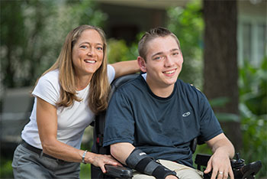
What is a Personal Support Worker (PSW)?
Personal Support Worker’s or PSW’s are people who provide supports to the individual receiving services.
Family members and friends can be Personal Support Workers.
All PSWs must pass a criminal history check and are mandatory abuse reporters.
PSW’s are independent contractors. They do not work for the brokerage.
PSW’s are employed by the Individual or their Employer of Record/designated representative.
PSW’s are paid by a mix of state and federal funding.
A PSW can work up to 40 hours a week or 50 hours a week if they have an overtime exception.
A PSW can also be a job coach. The PSW must complete job coach training requirements to be both.

Slide 18
Common PSW services:
Assisting with skill building to increase independence in daily living skills
Develop routines and assistance for grooming and hygiene
Nutrition and meal planning
Home organization and cleaning
Support with obtaining medical care, attending doctors appointments and follow-up health care
Transportation to access the community
Grocery shopping
Assist with achieving personal goals
Cognitive and emotional support during social activities
Communication assistance
General problem solving assitance

Slide 19
What are Waiver services?
Waivers waive the individuals right to receive services in an institution, making it possible for the individual to receive services in their community
In order for an individual to be eligible to receive waiver services they must:
Have OSIP-M
Meet ICF/IDD Level of Care
Have an assessed need for the service
Requires at least one waiver service every month
Have an ISP in place authorizing the chosen waiver service

Slide 20
Available with waiver services
Job Development
Job Coaching
Discovery
Small Group Supported Employment
Family training
Environmental Safety Modification
Vehicle Modification
Specialized Supplies
Waiver case management

Slide 21
Employment services
Discovery
Funded by brokerage services
Builds off of work completed during transition program.
Job Development
Typically funded by VR
Job Coaching
Typically is funded by VR for first 3 months
Long term supports begin funding job coach services once stabilization has been established
Small Group Supported Employment
Funded by brokerage services
2-8 individuals
Employment Path Services
Funded by brokerage
Only available after age 21*
Similar to VR career exploration service

Slide 22
Employment Path Services
Only Available after 21 unless there are no services available in local area.
Great service for individuals who graduate from transitions program, but is not ready for VR services
Employment and training programs
Typically more similar to actual community employment, not 1:1, group work
1:1 Employment Path services
Individualized, more support, relies on volunteer opportunities and community partnerships

Slide 23
Vocational Rehabilitation and Brokerage Services
Brokerage refers clients to VR services
Brokerage provides information for eligibility
Personal Agent can assist with input and support during VR meetings
Personal Agent completes Career Development Plan (CDP)
Completed CDP makes client eligible for employment services and identifies clients employment goals
Brokerage provides long term employment supports after VR has established stability

Slide 24
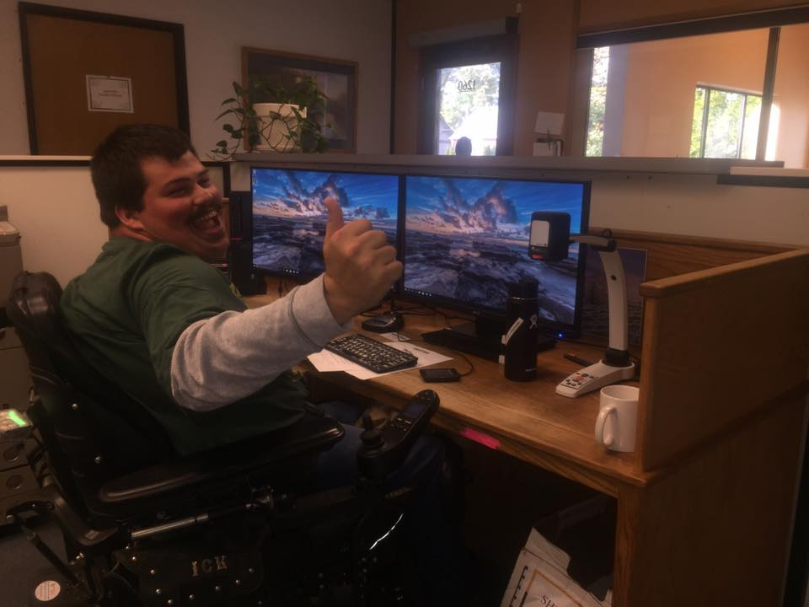
Nick’s Brokerage Services & VR
Nicks brokerage services helped him connect with Vocational Rehabilitation.
VR purchased Assistive Technology and other equipment so that Nick could be successful in his job. If it wasn't for his equipment Nick wouldn't be able to successfully do his job!
As Nicks employment goals changed over the years he went to his Personal Agent and they connected him with VR.

Slide 25
Brokerage Services Recap
We are a case management services available to individuals over 18 who are living in community setting.
We coordinate services, working with family and existing transitions team to fill service gaps and provide continuity of supports
We perform assessments, monitor services and write overall support plans for individuals based on their current needs.
We do not provide direct care, give rides, schedule medical appointments or employ Personal Support Workers.

Slide 26
Questions?

Slide 27
What can transitions services and DD services do to better collaborate?

