Slide 1

Introduction to
Oregon’s Quality Rating and Improvement System
Training Date
Trainer(s)
Trainer(s) Agency
Training Location
Notes:
Welcome activities
Introduce the title of the session from the PowerPoint slide. Also introduce yourself and provide a brief introduction of additional staff participating in training, if any.
Have participants introduce themselves or provide another activity designed for participants to be recognized.
Explain training materials. If you have table kits or other items available for participant use, explain how items are to be utilized.
Hand out Participant Packets (include agenda, PowerPoint slides, and any additional documents you have in packet) if participants have not already received them. Briefly go over Packets with participants if needed.
Point out there is space on the Power Point handout to take notes.

Slide 2
Session Outcome and Objectives
Understand the documents and process for participating in Spark
Gain the knowledge and tools needed to participate in Spark
Awareness of the Quality Improvement Plan
Understand the purpose of a QRIS and the Spark partners
Understand the portfolio submission and review process
Understand the supports and incentives for programs
Identify next steps
Notes:
Training outcome and objectives
Direct the participants to the PowerPoint slide on the screen and the PowerPoint handout page that has the outcome and objectives.
Read aloud the outcome.
Explain to participants that to achieve the outcome, we have developed a series of training objectives. Review the objectives from the slide.
Invite participants to ask questions and/or make comments about the outcome and objectives, as well as during any part of the training.
Housekeeping information
Remind participants that the session is two hours in length and that a lot of material will be covered. Refer participants to the training agenda in their Participant Packet.
Let participants know where the restrooms are located and inform them if there will be a break.
Ask participants to silence their cell phones and limit side conversations. You may also ask what other courtesies will help them to stay focused.
Inform participants that they will be completing an evaluation of the training at the end of the session.
Let participants know that they will receive a certificate for completing the training in the core knowledge category of Program Management.
Closing
Icebreaker activity (optional). One suggested activity is “Comfort Zones.” You can either just ask participants or have three Zones set up in the room, about their comfort level around Spark. The Zones can be something like “Comfortable”, “Some Understanding” and “Overwhelmed”. Ask the following statement, “How are you feeling about your understanding of Spark and the Spark process? Have participants either answer as a group or have them stand in front of the “Comfort Zone” that matches their comfort level. For the “Zones,” place three pieces of paper on the wall, labeled in order from Comfortable to Overwhelmed. Ask for volunteers to share their reasons for their Zone choice. Another way to frame this is asking about their fears and excitement.
Ask participants if they have any questions about the purpose/objectives of the training, the schedule, or anything else regarding the content covered so far

Slide 3
What is a QRIS?
Notes:
Objective title slide: We are going to generally define the purpose of a QRIS and how Spark specifically functions as Oregon’s QRIS.

Slide 4
Q
uality
R
ating
I
mprovement
S
ystem
Notes:
Quality
Purpose: A QRIS focuses on Quality. Research shows that quality experiences for children lead to better success in life. More high quality programs equal better outcomes for children.
Function: Spark functions to help incentivize better education and compensation so providers can deliver higher quality education to Oregon’s children.
Rating
Purpose: Ratings are a tool that can be used by programs to advertise their quality and by parents to help them understand quality.
Function: Rating are one of many ways to increase interest in something. For example, we rate restaurants, hotels, websites, and movies. Spark gives an expert backing (third party) to the rating of early learning and development programs (ELDP). Parents can use rating along with other indicators to make informed decisions about which provider to use to care for their children. A Spark rating is not the only way to for parents to know if they want their child/ren to attend a program.
Improvement
Purpose: Quality Improvement is the heart of a QRIS. Why is quality improvement important? Use an example of why staying current and continually improving is important. One example might be:
Imagine if your family doctor got her medical degree in 1972 and then never read another article, took another class or learned about new research or technology. Would you want to see a doctor who decided that a medical degree from 1972 and 35 years of experience was good enough? If doctors didn’t do quality improvement, they would miss out on vital information like new vaccines, treatments, and cures for formerly incurable diseases. It is our responsibility to do the same thing, which is to continually improve, and to be the best we can for the children in our care.
Function: In Spark a program that continues to improve its practices will be able to deliver relevant and high quality services to their enrolled families.
System (this is the segue from what a QRIS is and who the Spark partners are)
Purpose: Systems give credibility and support to programs there rating and their quality improvement.
Function: Spark is a part of our state’s Early Learning System. Spark can be compared to the Oregon Registry. Spark is the backbone of our state Early Childhood Education system. Spark ratings for example are include in legislation approve by the Oregon House and Senate and signed into law by the governor. The Oregon Registry provides standards, supports, and credibility for the workforce.

Slide 5

Spark Partners
Office of Child Care
Oregon Center for Career Development
Child Care Resource and Referral
The Research Institute at WOU
Notes:
Spark Partners
This slide shows that Spark was not developed and implemented in isolation. Each agency has an important piece.
Child Care Resource and Referral—Provides technical assistance, training, and support to programs for quality improvement.
The Research Institute at Western Oregon University—You will hear us refer to them as TRI or WOU. They are the QRIS implementers, providing technical assistance on portfolios, coordinating portfolio reviews and assigning quality ratings.
Oregon Center for Career Development—Key partner in Personnel Qualifications. They created and administer the Oregon Registry.
Office of Child Care—Funds the program and provides leadership and direction as well as a connection to the Early Learning Council/Early Learning Division.

Slide 6
Spark Overview
So, what is it?
Notes:
Objective title slide: We just finished talking about what a QRIS is and our Spark Partners now we are going to discuss the components, tiers, structure, materials, domains and standards, and building blocks of Spark.

Slide 7
Building Block with 5 Tiers
5 Domains
Quality Improvement
Multiple Versions of Materials
Quality Rating
Spark Components
Quality Improvement Plans
Incentives
Portfolio System of Documentation
Supports
Self- Assessments
Notes:
Spark Components
As we said before, Spark is a system with many parts.
The large, blue box (Spark Components) encompasses the system.
Our system is a building block system with 5 tiers. The next slides show us how that works.
Our standards are broken into 5 domains (Learning & Development, Health & Safety, Personnel Qualifications, Family Partnerships and Administration & Business Practices).
There are two versions of the materials, one for family-based programs and one for center-based programs. The standards are the same, but the language is different in places. This means that a 3-star center program and a 3-star family program meet the same level of quality because we know that what is good for children is good for children, no matter what the setting might be.
The Quality Improvement component includes a Self-Assessment for the program, a Quality Improvement Plan that guides our work together and helps you set goals for quality improvements you want to make, supports which include help from a Quality Improvement Specialist, and access to resources and financial supports.
The Quality Rating component shows the portfolio system and incentives.
Spark is unique in that we use the portfolio system. As we mentioned earlier, Oregon is using a cost efficient measure of quality because of the commitment to spend more money supporting programs than rating them. Many states pay multiple observers to go on site and rate programs. Oregon asks programs to document their quality practices in a portfolio.
Financial incentives are tied to the quality ratings (programs receive the incentive funds after they achieve a star rating).

Slide 8
Spark 5 Tier Building Block System
Supports
for Quality Improvement
Incentives for Quality Rating
Commitment to Quality
Licensed
Notes:
Spark 5 Tier Building Block System
Use this visual to explain the tiers, when supports are available, and what incentives are available. Mention that we will be explaining the supports and incentives later.
Mention the 5 tiers. Explain that one cannot achieve a high tier without first achieving all of the lower tiers (building block system).
Everything starts with licensing.
Support funds available when you are Commitment to Quality or C2Q.
Incentive funds available when as you progress through each star rating.

Slide 9
Spark Structure
Domains
Standards
Indicators
Evidence
Found in portfolio only
Measurable indicators of standards
5 total
33 total
Star levels of standards
Overall categories of quality
Program standards, organized by domain
Usually 3 per standard
Some standards only have 1 or 2 indicators
Notes:
Spark Structure
This slide illustrates the structure of how the Spark Domains, Standards, Indicators and Evidence fit together.
Walk the participants through the levels on the slide. The slide summarizes the main points for the Domains, Standards, Indicators and Evidence.
Domains are the overall categories of quality, there are 5 total domains.
Standards, these standards are organized by domain, there are 33 total standards.
There are indicators for each Star level for each standard. Usually 3 per standard; however, some standards only have 1 or 2 indicators.
Evidence is only found in the portfolio. The evidence is the measurable indicators of the standards.

Slide 10
Spark Domains and Standards
Children’s Learning and Development
12 Standards
Health and Safety
6 Standards
Personnel Qualifications
Family Partnerships
Administration and Business Practices
6 Standards
4 Standards
5 Standards
Notes:
Spark Domains and Standards
This slide shows the 5 Spark Domains and Standards.
The Domains represent the major areas of quality. These were identified based on what we know about what makes up a quality program.
The Standards are a breakdown of items that together make up the content of the Domains. We have tried to identify only the essential items for each Domain.
You can see from the slide that the number of Standards in the Domains ranges from 4 to 12.
For some family child care providers some of the standards are not applicable.

Slide 11
Spark Supports and Incentives
Notes:
Objective title slide: Let’s talk about what types of supports and incentive are available to you including financial and professional.

Slide 12
Spark Supports
Oregon’s QRIS Resources Website (oregonqrisresources.org)
Quality Improvement Specialists (QIS)
Portfolio
Financial
Notes:
Spark Supports
Spark supports are available to eligible programs to assist them with program improvement.
There are a number of supports available to programs (briefly review the list on the slide).
The Oregon QRIS Resources website is available to programs after they achieve the Commitment to Quality designation. This website offers sample forms and other information to assist with program improvement.
Quality Improvement Specialists are from CCR&Rs that are available to assist programs with program improvements.
Portfolio support is available from TRI/WOU to address questions that programs may have as they put their portfolios together.
A variety of Oregon Spark web-based supports are available to programs including a Frequently Asked Questions page.
Financial supports that we will talk about next.

Slide 13
Financial Supports
Most C2Q programs are eligible for support funds
Amount determined by licensed capacity of program
Must be used to support quality improvements
Notes:
Financial supports
Refer participants to the appendices in the back of their participant packet for the Explanation of Supports form.
Programs are offered support money for quality improvement. You will see on your Explanation of Support Form how much you are eligible for.
Most Commitment to Quality (C2Q) programs are eligible for support funds.
Financial support funds are to be used for program improvement.

Slide 14
Request for Supports
Complete and submit Request for Supports form to TRI
Complete and submit WOU substitute W-9 Form
Work with a QIS to identify and support program improvement
Implement program quality improvement
Notes:
Request for Supports
For programs that want to receive supports to make program improvements before submitting a portfolio these are the steps they need to take.
Complete and submit the Request for Supports form to The Research Institute (TRI).
Complete and submit the WOU Substitute W-9 form to TRI. Assuming you’ve completed your Request for Supports and WOU Substitute W-9 correctly, you should expect your support check to arrive in 15-30 days.
Work with your Quality Improvement Specialist to identify and help support you in your program improvements. Your QIS may also be able to help you choose how to spend your support money wisely.
Implement your program quality improvements that were identified on your Quality Improvement Plan or with help from your QIS.
Ask participants if they have any questions about the material covered in this section.
Briefly walk the participants through the Request for Support form and answer any questions they might have.

Slide 15
What Can Support Money be Spent On?
Quality Improvement!
Quality Improvement!
Quality Improvement!
Remember to save your receipts!
Notes:
What Can I Spend My Support Money On?
1. One of the questions that gets asked most often is: What can I spend my support money on?
2. There are just 3 things you can spend your money on:
Quality Improvement
Quality Improvement!
QUALITY IMPROVEMENT!
3. Remember to save your receipts for 7 years. You may be audited and must be able to provide receipts for the full amount and must be able to justify that the money was spent on quality improvement. The best way to do this is to use your Quality Improvement Plan to track the improvements made with the purchases.

Slide 16
Incentive & Support Money Cannot Be Used for:
Capital improvements
Sectarian materials
Operating costs
Anything that cannot be justified as quality improvement on a Quality Improvement Plan
Notes:
Incentive & Support Money Cannot Be Used for:
1. The Incentive & support money must be used within these guidelines because they are federal monies. Review the items on the slide.
a. Capital improvements includes permanent improvements such as construction of built-in shelves, patios, concrete pads, etc. (anything that you can’t take with you if you moved).
b. Sectarian materials. Federal monies cannot be used to purchase religious materials.
c. Operating costs includes items such as rent, water, staff salaries, etc.
2. Remember, your QIS can help you decide how to best spend these monies.

Slide 17
Financial Incentives
Awarded by TRI after program receives a star rating
Amount depends on size of program and rating awarded
Recognizes achievements and provides support for ongoing cost of quality
Restriction same as Support funds
Notes:
Financial Incentives
Financial incentives are different than support dollars.
They are awarded by TRI after a program receives star quality rating.
The amount depends on the size of the program and quality rating awarded.
The incentive money recognizes achievements and provides support for the ongoing cost of quality.
Financial incentives are for the program. Same restrictions as Support funds.

Slide 18
Commitment to Quality (C2Q) Phase
Notes:
Introduction
During this session, we will be talking about the documents and process of the C2Q Phase.

Slide 19
Commitment to Quality Process
  What you need to mail in to start the process
    Completed program application
    Signed MOU
Pass compliance requirements
If your application is approved for a Commitment to Quality level, you will receive a Welcome Kit
Notes:
C2Q Process
In order to start the C2Q process you will need to mail a completed Spark Application and a signed Memorandum of Understanding (MOU) to TRI.
You will also need to pass the C2Q compliance requirements.
After application items are reviewed and determined to be complete, programs will receive their C2Q designation and a Welcome Kit.

Slide 20
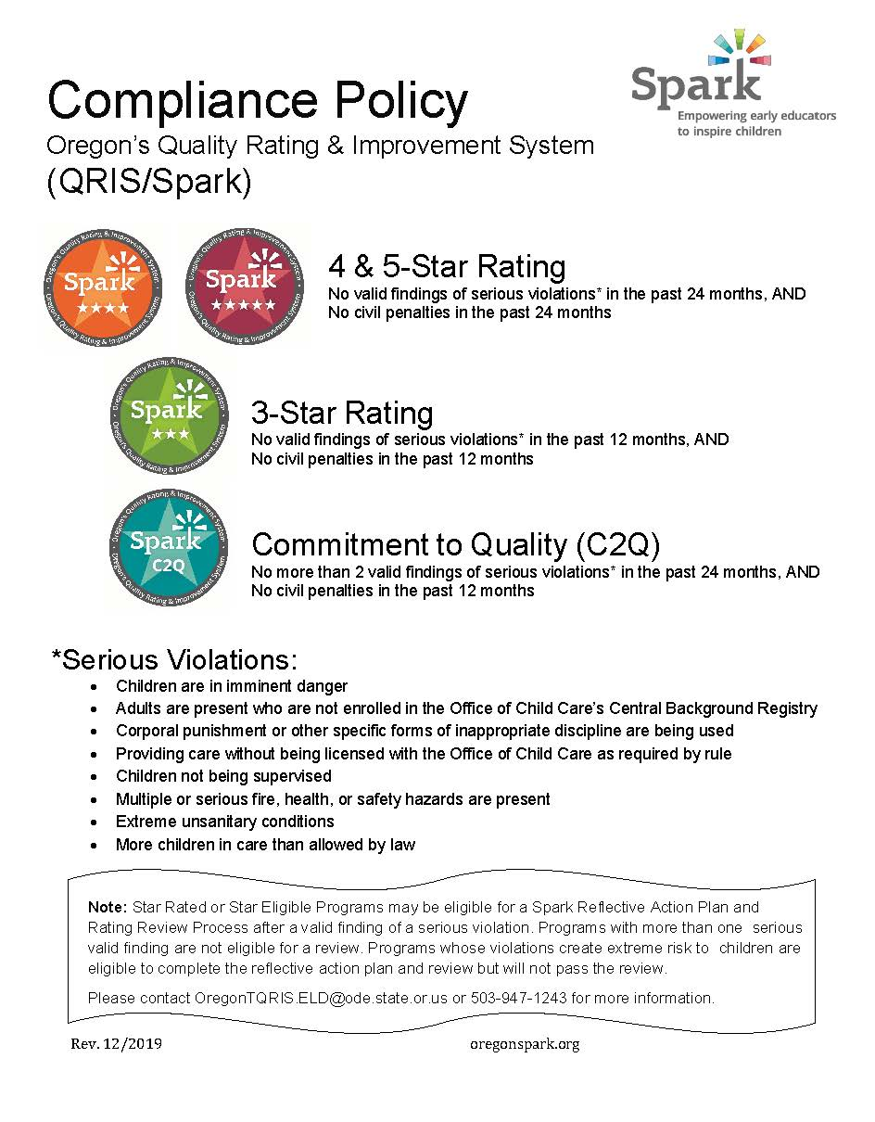
Notes:
Trainer Notes:
Here is the compliance poster

Slide 21
Program Application
Provides basic information on program
Identifies Spark lead
Clarifies C2Q requirements
Notes:
Program Application
A. Hand out a copy of the Application if you have not already done so.
B. The purpose of the Program Application is to collect information about the program including contact information, the type of program, other general program information, information related to requirements for participating in Spark, and if the program meets C2Q requirements. The application serves as the “gateway” to the Spark process. A program must meet the minimum requirements described within the Application to be eligible to achieve a C2Q designation.
C. If there is time at the end of the training you can help the programs complete the Application.

Slide 22
Memorandum of Understanding (MOU)
Agreement to participate in Spark
Keep first page and return signature page only
Notes:
Memorandum of Understanding (MOU)
A. Hand out a copy of the MOU if you have not already done so.
B. The MOU contains information that programs agree to adhere to to participate in Spark.
C. If there is time at the end of the training you can have the programs read through and sign the MOU.

Slide 23
Self-Assessment
Starting point for Spark
Two versions: Center and Family
Tool to begin to understand Spark standards
Reflect on your program practices
Notes:
Self-Assessment
A. Hand out a copy of the Self-Assessment if you have not already done so.
B. The purpose and the format for the Self-Assessment
1. Part of the Spark process is to complete the Self-Assessment. This is a simplified way for programs to get an idea of how their program aligns with the Spark standards and how ready they may be to proceed in the process.
2. There are two versions of the Self-Assessment – a Center version and a Family version.
3. The Self-Assessment is taken directly from the Portfolio. If you are somewhat accurate in your assessment, you will have a good idea of your program’s readiness to proceed and what star level is attainable.
4. It is not intended to be an exact assessment. The person completing it should give their best guess or choose “partial” if they are not sure how to rate an item.
5. Programs will not be judged on where they assess themselves. The process of doing the reflection is all that is required.
6. Let the participants know that you (QIS) will be available to give them additional information on how to fill out the Self-Assessment when they are ready for this step.

Slide 24

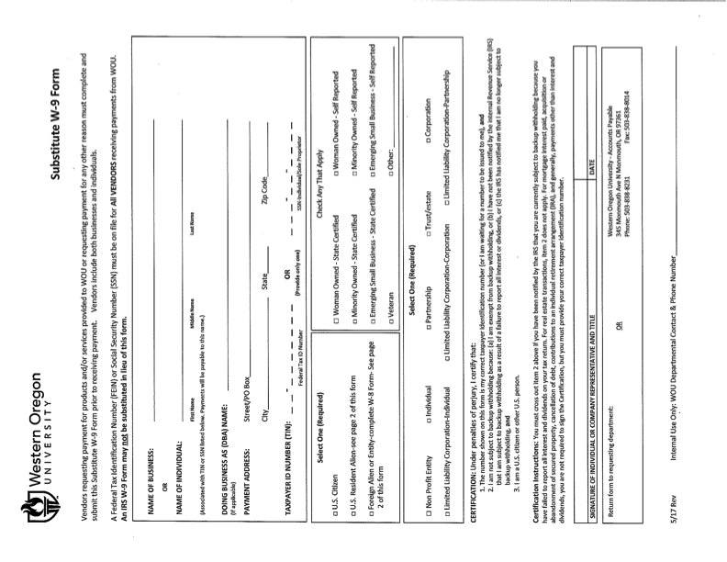

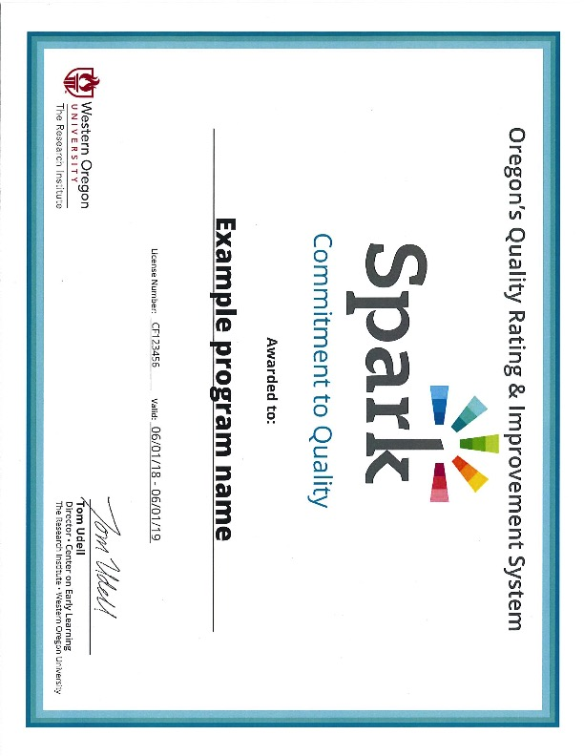
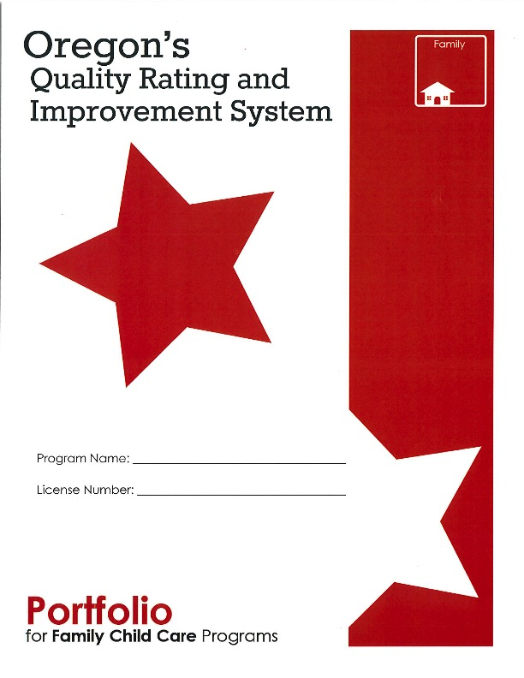
Welcome Kit
Notes:
Welcome Kit
A. After a program submits their completed Application and signed Memorandum of Understanding, and they pass the compliance check, they will receive their C2Q Welcome Kit.
B. Using the Example Welcome Kit quickly show them the contents.

Slide 25
Determine your next steps
YOU choose how to proceed
No right or wrong way
Notes:
Determine Your Next Steps
A. After a program completes the initial activities and they receive their Commitment to Quality designation and their Welcome Kit, they are ready to proceed on to the next part of the process.
B. Each program gets to choose how they want to go through the process.
C. There is not one right or wrong way.
D. Programs may want to go directly to obtaining a rating or may want to spend some time making improvements and get support before they get rated.
VIII. Ask participants if they have any questions about the content covered in this section.

Slide 26
Quality Improvement Phase

Slide 27
Quality Improvement Plan (QIP) What is it and why is it important?
Guides your Spark process
Includes all domains, standards and indicators
Documents your need for support funds
Outlines a plan for receiving supports from QIS
You choose how to use it
QIS can help you fill it out
Notes:
Quality Improvement Plans – Why are they important?
The QIP is the heart and soul of Spark.
We talked in the beginning of the presentation about what each letter in QRIS stands for… “I” represents improvement, continuous quality improvement. The QIP provides a map to achieve your goals.
The QIP enables programs who have achieved the Commitment to Quality designation to take the next step in the Spark process.
Filling out and completing the QIP allows programs to not only receive financial supports, but it also enables them to indicate to their Quality Improvement Specialist what special assistance they may need to be successful during the QRIS process and beyond. So, what is the Quality Improvement Plan?
The QIP is a tool for you to use to map out your goals and accomplishments in improving the quality of your program.
QIP – What is it and why is it important?
The QIP guides your own personal QRIS process.
The QIP includes all domains, standards and indicators, but you choose how you want to use it.
The QIP documents your need for support funds.
The QIP outlines a plan for receiving supports from Quality Improvement Specialist.
Your QIS can help you fill it out when you are ready.

Slide 28
Quality Rating Phase
Notes:
Quality Rating Phase
The Quality Rating Phase occurs after the program has achieved a C2Q designation and they have completed the necessary quality improvements identified in their QIP.

Slide 29
Portfolio
Chance to show off your program
Document evidence
Required for a rating
Resubmit as many times as you want
Notes:
Completing your portfolio is your chance to show off what your program does.
Your portfolio documents your program’s quality, including quality improvements.
Completing and submitting a portfolio is required for a quality rating.
Keep in mind that ratings are never final; you can resubmit as many times as you want.

Slide 30
Evidence
Measurable indicator of the quality of a program
Submit the type of evidence asked for in the portfolio
May add supplemental evidence
Don’t omit any required evidence
Notes:
Evidence
Your program will be asked to document your program quality against the Spark standards by submitting evidence.
The portfolio will tell you the type of evidence that you need to submit for each indicator. You may add supplemental evidence not asked for, but be sure that you submit the evidence that is required.
Types of evidence may include photographs, written descriptions, copies of program policies, and others.

Slide 31
Evidence by Program Type
Some standards are classroom-specific
Submit evidence for each classroom
Some standards are age-specific
Submit evidence for each age group
Multiple licensing locations
Contact TRI for details
Notes:
Evidence by Program Type
The Spark designation is given by Office of Child Care (OCC) licensing location.
If a program has multiple classrooms at one location, certain indicators will require that items of evidence be submitted for each classroom at that location.
Multiple classrooms may include more than one classroom for an age group or different age groups (infants/toddlers/preschool/school age).
If a program has multiple licensed locations, they can choose whether to submit for Spark designation for one, some or all of the locations.
If a program will be seeking a Spark designation for multiple sites, they should contact The Research Institute for more information about portfolio requirements.

Slide 32
Portfolio Development and Submission Process
1
2
3
4
Compile evidence for star level — evidence must be provided for EVERY indicator
Place labeled evidence in portfolio
Check box indicating evidence has been provided
Submit portfolio & policy handbook to TRI for review
Notes:
Portfolio Development and Submission Process
After you complete the Quality Improvement Plan and have deemed yourself “portfolio ready”, you will begin these steps.
Compile your evidence. Remember, if you’re going for a 4-star, you must address all 3-star and 4-star indicators. If you’re going for a 5-star, you must address every 3-star and 4-star indicator.
Place your evidence into the portfolio, hole punch it and keep it nice and organized as it is a representation of your program. Labeling your evidence and highlighting where you want the reviewer to look are very helpful practices.
Once all the information is compiled for a single indicator, check the box indicating that the evidence has been provided.
Once you have all your evidence compiled, have your QIS or a peer review your portfolio to ensure you’ve addressed all of the criteria. Then submit your portfolio to The Research Institute. Don’t forget to include your policy hand book with your portfolio.
Don’t forget to look at the scoring guide to help you understand how your portfolio will be rated.

Slide 33
Portfolio Review Process
Mail or deliver complete portfolio
Program notified of decision
Spark Review Team examines portfolio
Completeness check by TRI
Spark rating assigned
Portfolio and designation materials mailed back
Program may resubmit at any time!
Notes:
Portfolio Review Process
Portfolios can be submitted at any time and can be mailed to The Research Institute or delivered in person.
Once The Research Institute receives the portfolio, an initial screening (completeness check) is completed. If upon the initial review The Research Institute determines that your portfolio is not ready to be reviewed by the review team, your portfolio will be returned to you. Make sure before mailing it that it is complete.
Assuming the portfolio passes the completeness check, it will move onto the review team to be reviewed.
After the review, a Spark rating will be assigned and programs will then be notified of the rating.
The portfolio and designation materials will be mailed back to the program, including specific feedback.
A program can resubmit their portfolio at any time.

Slide 34
Scoring
 | Learning and Development | Health and Safety | Personnel Qualifications | Family Partnerships | Administration and Business Practices
Total number of standards needed to pass each domain | 10 | 5 | 5 | 3 | 5
Total number of standards in each domain | 12 | 6 | 5 | 4 | 6
Notes:
Scoring
Minimum to Pass – review the requirements from the PowerPoint slide.
Portfolios that meet the criteria above will pass at the star level they are submitting for.
For example, a program must pass 10 out of the 12 standards in the Learning and Development domain.
Five out of the 6 standards in the Health and Safety domain.
100% or 5 out of the 5 standards in the Personnel Qualifications domain.
Three out the 4 standards in the Family Partnership domain.
Five out the 6 standards in the Administration and Business Practices domain.
Upon designation, programs will receive their portfolio along with a copy of their scoring guide.
Additionally, programs will also receive their designation materials (e.g., certificate indicating star level achieved, templates to help construct newsletters, window clings, etc.)

Slide 35
Continuous Quality Improvement Phase
Notes:
Continuous Quality Improvement Phase
Emphasize to the participants that program improvement does not end once they submit their portfolios and they get a quality rating. This phase of the QRIS process reinforces the importance of continuous quality improvement.

Slide 36
After Portfolio Review
Portfolio returned to program
Programs receive feedback on summary score sheet on EVERY indicator attempted but not achieved
Feedback is given on portfolio organization
Program sent designation materials if star rating achieved
Programs are eligible to resubmit at anytime
Notes:
After Portfolio Review
Discuss the content on the slide. This slide describes what happens after a portfolio is reviewed by the Spark Review Team.

Slide 37
Portfolio Resubmission
Use your portfolio resubmission form as a guide for resubmission
Resubmit evidence only for indicators that did not pass
You may resubmit for a higher star level
Notes:
Portfolio Resubmission
After you submit your portfolio and you get a rating, you should continue with program improvement.
Use your current portfolio to build on your program quality.
Resubmit evidence only for indicators that did not pass.
You can resubmit for star level initially attempted or can resubmit for higher star level using the same portfolio.
The Portfolio Resubmission form is included with the feedback; use it as a guide for resubmission.

Slide 38
Quality Maintenance
Programs must maintain quality
Programs must maintain compliance requirements
Complete Spark Program Update Report (Spur) annually or when significant program changes are made
Notes:
Quality Maintenance
Review the points on the PowerPoint slide that address maintaining program quality.
Ask the participants if they have any questions about anything that has been covered during the training or any other questions they may have related to the QRIS.

Slide 39
Wrap up
Notes:
Introduction
During this training, we have talked about the Spark process and how programs get involved.
During this section, we are going to be talking about the following topics:
Next Steps
Resources
You have completed the first step in the Spark process by attending this Introduction to Spark Training session. Now we are going to be talking about the next steps if you decide to be involved in the Spark process.
If you are not sure that your program wants to go through the process of developing and submitting a portfolio to obtain a star rating, we would like you to consider pursuing the Commitment to Quality designation.

Slide 40

Next Steps
    Complete Program Application
    Begin filling out Self-Assessment
    Complete the MOU
    Send the completed application and MOU to TRI
    After your paperwork is reviewed at TRI and the compliance check is completed, you will receive your C2Q designation and Welcome Kit
Notes:
Next Steps: Application Process
A. Complete the Program Application
B. Take some time to fill out the Self-Assessment, urge participants to complete it when they return to their program
C. Complete and sign the Memorandum of Understanding (MOU)
D. Send the completed Application, Self-Assessment and MOU to TRI. Be sure to make copies and keep the originals for your records.
E. After TRI staff review your paperwork and the compliance check is completed, you will receive your Commitment to Quality designation and Welcome Kit.

Slide 41
Next Steps
      After you receive the Welcome Kit, you need to decide how you want to proceed
      Your Self-Assessment, Quality Improvement Plan, and your QIS will help you
Notes:
Next Steps: Welcome Kit
After you receive the Welcome Kit, you need to decide how you want to proceed: 1) stay at the Commitment to Quality level; 2) complete your portfolio without supports; or 3) request supports to support program improvement and submit your portfolio.
What you do next will depend on how you want to proceed.
If you decide to proceed with the Spark process, the next step is entering the Quality Improvement Phase. You have a choice to go directly towards working on your portfolio, or you may choose to fill out a Quality Improvement Plan and apply for financial supports. If you choose to apply for financial supports, it’s highly recommended to work with a Quality Improvement Specialist (QIS).
Spark is not only about receiving a rating, but more importantly, about continuous program improvement. Even if you decide not to participate further in Spark, you should still consider continuing to identify areas to increase the quality of your program.
We hope that you have decided/will decide to participate in Spark. Your involvement will allow you and the families you serve to celebrate and acknowledge the achievements your program has made (through your rating) as well as to provide resources and support to help with program improvements.
Ask the participants to make a commitment to start the process. Inform them of any upcoming workshops or work sessions that might help them get started.

Slide 42



Resources Available
Program Improvement:
  Quality Improvement Specialist at local CCR&R or Hub
  Oregon QRIS Resources Website www.OregonQRISResources.org
Portfolio, Financial & General Spark Information
  Quality Improvement Specialist at local CCR&R or Hub
  The Research Institute:
    Spark Helpline: 1-877-768-8290
    Email: QRIShelp@wou.edu
    Website: triwou.org/spark
Notes:
Resources Available:
As you work through the Spark process or if you have questions about Spark, remember that you have a number of resources available to help you.
1. For questions or help and for resources related to program improvement you can contact your Quality Improvement Specialist, the CCR&R ORO specialist, or access the Oregon’s Spark Resources website.
2. For questions related to completing your portfolio you should contact TRI at Western Oregon University. Their toll free helpline number is 877-768-8290 or e-mail qrishelp@wou.edu
3. The Spark website (triwou.org/spark) also has general information. There is a FAQ page on the website that answers common questions.
. Reflective Activity (optional)
One suggestion is to revisit the Comfort Zone activity. If short on time, you can ask the same question as in Section 1 to the whole group and have participants volunteer to share their thoughts.

Slide 43
Thank you!
Notes:
Closing
Announce that this is the closing section and describe the activities:
This section will take about 10 minutes.
Inform participants that they will complete an evaluation to give us feedback on this workshop.
Explain that certificates will be issued at the close of the workshop.
Workshop evaluation
Explain that we evaluate our training so we can be sure it is helpful to our participants.
Encourage participants to let us know what portions of the training were particularly useful for them and to also let us know what could be improved upon and how.
Remind participants they do not have to put their name on the evaluation.
Have participants complete their evaluation forms and turn them in to you.
Certificates
Thank participants for their participation and hand them their certificates. Note that the number of hours of the workshop is on the certificate. Also let them know that they should file it along with their objectives since they can be used to document contact hours for the Oregon Registry to move up on Registry Steps and the Office of Child Care for licensing requirements.
Invite participants to contact you if they have any questions and remind them that there is a lot of support available for the Spark process

