Slide 1
Introducción al Sistema de Calificación y Mejora de la Calidad de Oregon
Fecha del entrenamiento
Entrenador(es)
Agencia de Entrenador(es)
Lugar del entrenamiento
Notes:
Welcome activities
Introduce the title of the session from the PowerPoint slide. Also introduce yourself and provide a brief introduction of additional staff participating in training, if any.
Have participants introduce themselves or provide another activity designed for participants to be recognized.
Explain training materials. If you have table kits or other items available for participant use, explain how items are to be utilized.
Hand out Participant Packets (include agenda, PowerPoint slides, and any additional documents you have in packet) if participants have not already received them. Briefly go over Packets with participants if needed.
Point out there is space on the Power Point handout to take notes.

Slide 2
Resultados de la sesión y objetivos
Notes:
Training outcome and objectives
Direct the participants to the PowerPoint slide on the screen and the PowerPoint handout page that has the outcome and objectives.
Read aloud the outcome.
Explain to participants that to achieve the outcome, we have developed a series of training objectives. Review the objectives from the slide.
Invite participants to ask questions and/or make comments about the outcome and objectives, as well as during any part of the training.
Housekeeping information
Remind participants that the session is two hours in length and that a lot of material will be covered. Refer participants to the training agenda in their Participant Packet.
Let participants know where the restrooms are located and inform them if there will be a break.
Ask participants to silence their cell phones and limit side conversations. You may also ask what other courtesies will help them to stay focused.
Inform participants that they will be completing an evaluation of the training at the end of the session.
Let participants know that they will receive a certificate for completing the training in the core knowledge category of Program Management.
Closing
Icebreaker activity (optional). One suggested activity is “Comfort Zones.” You can either just ask participants or have three Zones set up in the room, about their comfort level around Spark. The Zones can be something like “Comfortable”, “Some Understanding” and “Overwhelmed”. Ask the following statement, “How are you feeling about your understanding of Spark and the Spark process? Have participants either answer as a group or have them stand in front of the “Comfort Zone” that matches their comfort level. For the “Zones,” place three pieces of paper on the wall, labeled in order from Comfortable to Overwhelmed. Ask for volunteers to share their reasons for their Zone choice. Another way to frame this is asking about their fears and excitement.
Ask participants if they have any questions about the purpose/objectives of the training, the schedule, or anything else regarding the content covered so far

Slide 3
¿Qué es el QRIS?
Notes:
Objective title slide: We are going to generally define the purpose of a QRIS and how Spark specifically functions as Oregon’s QRIS.

Slide 4
Sistema de Calificación y Mejora de la Calidad
(QRIS)
Notes:
Quality
Purpose: A QRIS focuses on Quality. Research shows that quality experiences for children lead to better success in life. More high quality programs equal better outcomes for children.
Function: Spark functions to help incentivize better education and compensation so providers can deliver higher quality education to Oregon’s children.
Rating
Purpose: Ratings are a tool that can be used by programs to advertise their quality and by parents to help them understand quality.
Function: Rating are one of many ways to increase interest in something. For example, we rate restaurants, hotels, websites, and movies. Spark gives an expert backing (third party) to the rating of early learning and development programs (ELDP). Parents can use rating along with other indicators to make informed decisions about which provider to use to care for their children. A Spark rating is not the only way to for parents to know if they want their child/ren to attend a program.
Improvement
Purpose: Quality Improvement is the heart of a QRIS. Why is quality improvement important? Use an example of why staying current and continually improving is important. One example might be:
Imagine if your family doctor got her medical degree in 1972 and then never read another article, took another class or learned about new research or technology. Would you want to see a doctor who decided that a medical degree from 1972 and 35 years of experience was good enough? If doctors didn’t do quality improvement, they would miss out on vital information like new vaccines, treatments, and cures for formerly incurable diseases. It is our responsibility to do the same thing, which is to continually improve, and to be the best we can for the children in our care.
Function: In Spark a program that continues to improve its practices will be able to deliver relevant and high quality services to their enrolled families.
System (this is the segue from what a QRIS is and who the Spark partners are)
Purpose: Systems give credibility and support to programs there rating and their quality improvement.
Function: Spark is a part of our state’s Early Learning System. Spark can be compared to the Oregon Registry. Spark is the backbone of our state Early Childhood Education system. Spark ratings for example are include in legislation approve by the Oregon House and Senate and signed into law by the governor. The Oregon Registry provides standards, supports, and credibility for the workforce.

Slide 5
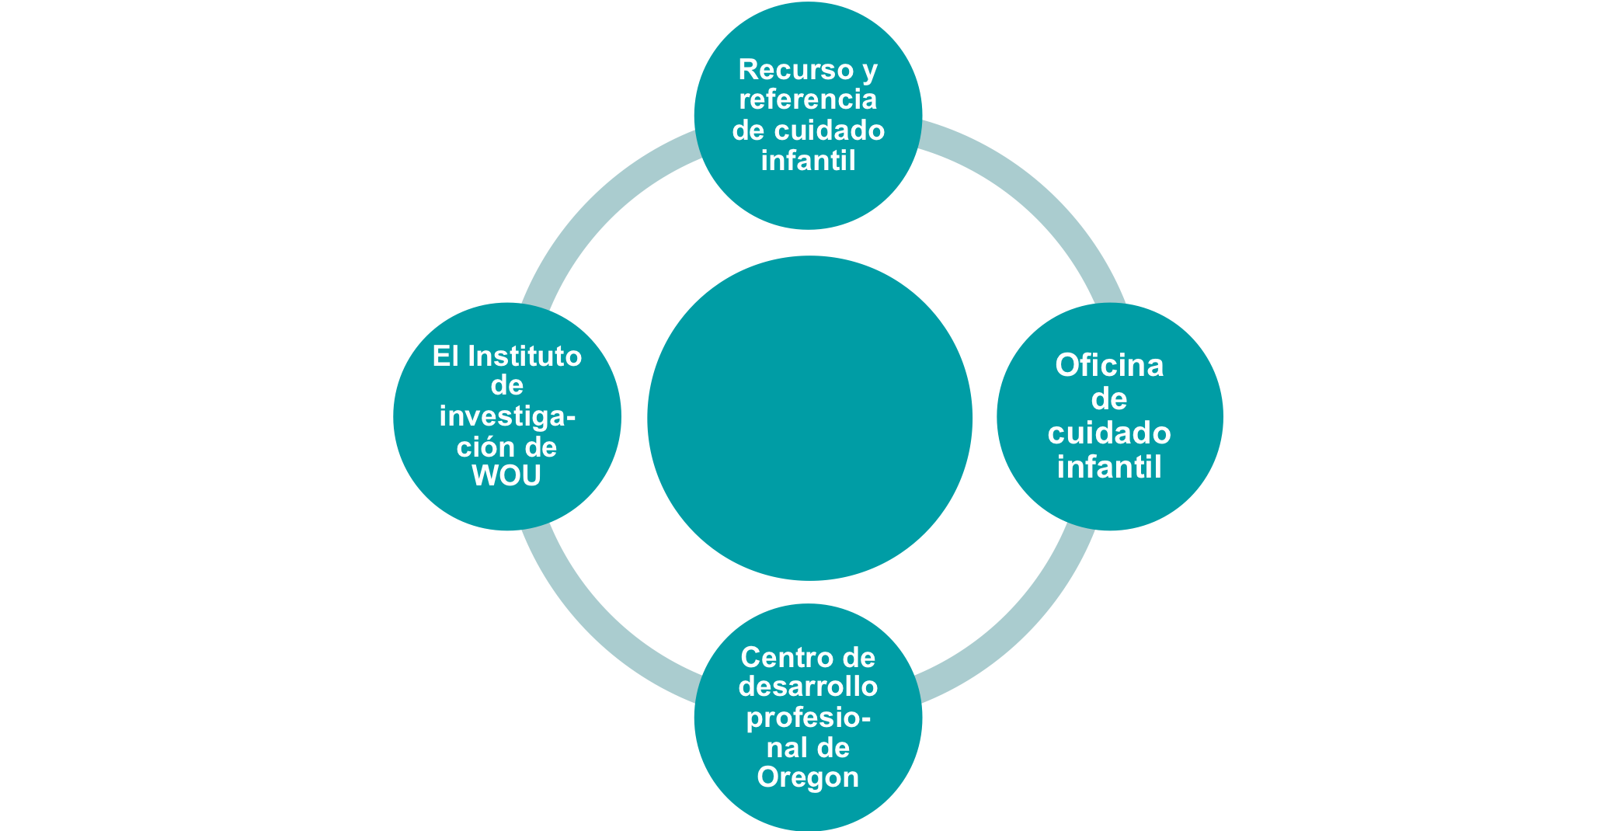
Socios de Spark
Notes:
Spark Partners
This slide shows that Spark was not developed and implemented in isolation. Each agency has an important piece.
Child Care Resource and Referral—Provides technical assistance, training, and support to programs for quality improvement.
The Research Institute at Western Oregon University—You will hear us refer to them as TRI or WOU. They are the QRIS implementers, providing technical assistance on portfolios, coordinating portfolio reviews and assigning quality ratings.
Oregon Center for Career Development—Key partner in Personnel Qualifications. They created and administer the Oregon Registry.
Office of Child Care—Funds the program and provides leadership and direction as well as a connection to the Early Learning Council/Early Learning Division.

Slide 6
Descripción general de Spark
Entonces, ¿qué es?
Notes:
Objective title slide: We just finished talking about what a QRIS is and our Spark Partners now we are going to discuss the components, tiers, structure, materials, domains and standards, and building blocks of Spark.

Slide 7
Notes:
Spark Components
As we said before, Spark is a system with many parts.
The large, blue box (Spark Components) encompasses the system.
Our system is a building block system with 5 tiers. The next slides show us how that works.
Our standards are broken into 5 domains (Learning & Development, Health & Safety, Personnel Qualifications, Family Partnerships and Administration & Business Practices).
There are two versions of the materials, one for family-based programs and one for center-based programs. The standards are the same, but the language is different in places. This means that a 3-star center program and a 3-star family program meet the same level of quality because we know that what is good for children is good for children, no matter what the setting might be.
The Quality Improvement component includes a Self-Assessment for the program, a Quality Improvement Plan that guides our work together and helps you set goals for quality improvements you want to make, supports which include help from a Quality Improvement Specialist, and access to resources and financial supports.
The Quality Rating component shows the portfolio system and incentives.
Spark is unique in that we use the portfolio system. As we mentioned earlier, Oregon is using a cost efficient measure of quality because of the commitment to spend more money supporting programs than rating them. Many states pay multiple observers to go on site and rate programs. Oregon asks programs to document their quality practices in a portfolio.
Financial incentives are tied to the quality ratings (programs receive the incentive funds after they achieve a star rating).

Slide 8
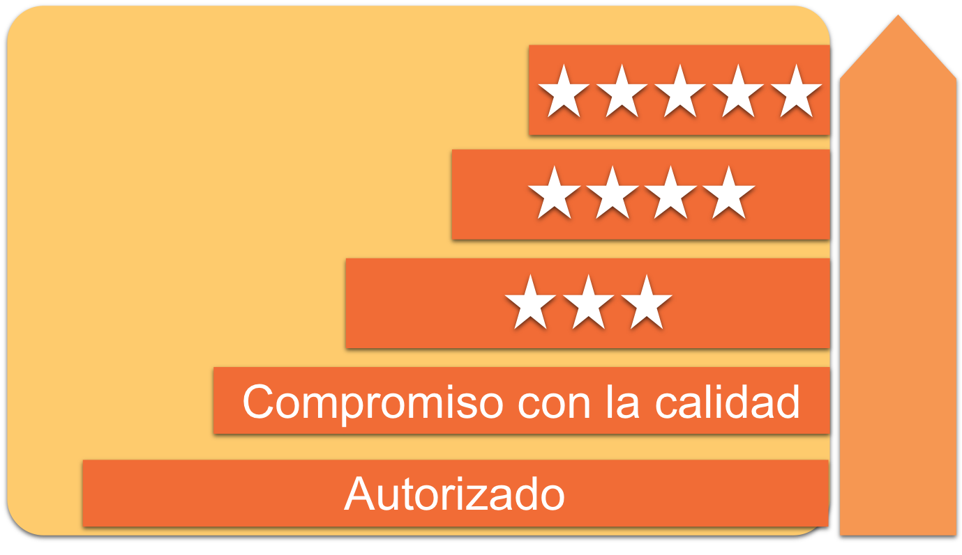
Sistema de 5 niveles de componentes básicos de Spark
Apoyos
para mejorar la calidad
Incentivos para la calificación de la calidad
Notes:
Spark 5 Tier Building Block System
Use this visual to explain the tiers, when supports are available, and what incentives are available. Mention that we will be explaining the supports and incentives later.
Mention the 5 tiers. Explain that one cannot achieve a high tier without first achieving all of the lower tiers (building block system).
Everything starts with licensing.
Support funds available when you are Commitment to Quality or C2Q.
Incentive funds available when as you progress through each star rating.

Slide 9
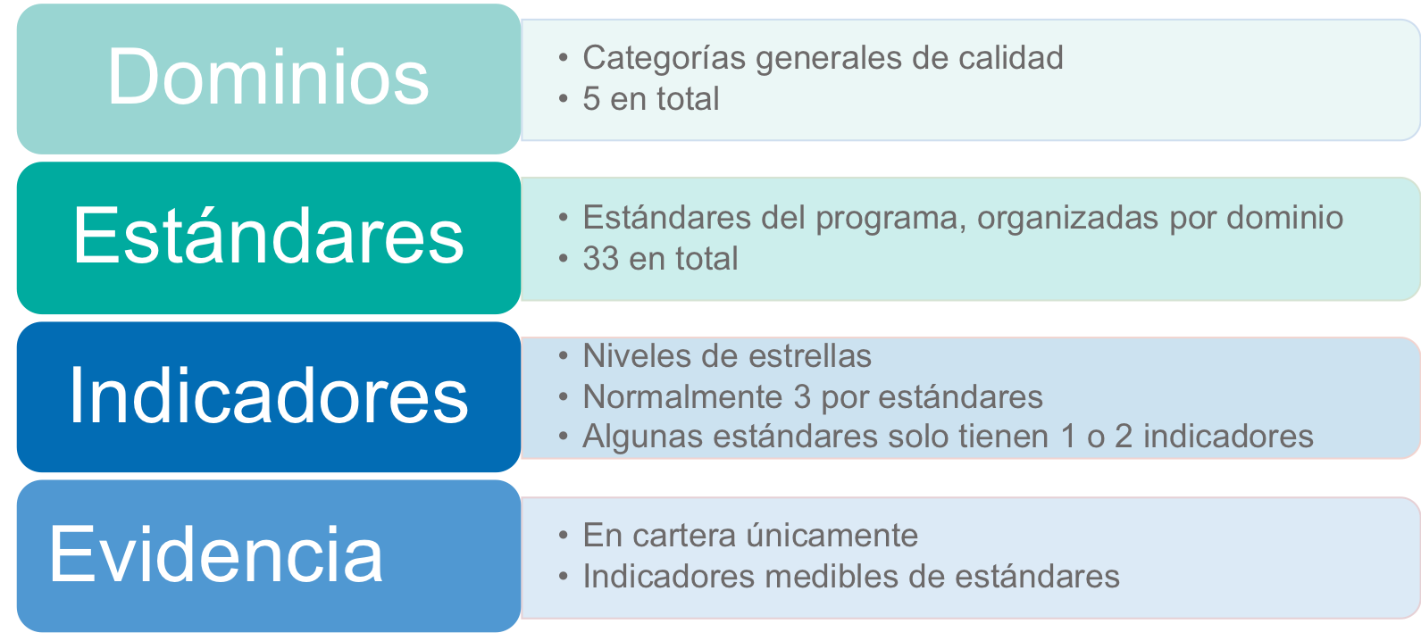
Estructura de Spark
Notes:
Spark Structure
This slide illustrates the structure of how the Spark Domains, Standards, Indicators and Evidence fit together.
Walk the participants through the levels on the slide. The slide summarizes the main points for the Domains, Standards, Indicators and Evidence.
Domains are the overall categories of quality, there are 5 total domains.
Standards, these standards are organized by domain, there are 33 total standards.
There are indicators for each Star level for each standard. Usually 3 per standard; however, some standards only have 1 or 2 indicators.
Evidence is only found in the portfolio. The evidence is the measurable indicators of the standards.

Slide 10
Dominios y estándares de Spark
Notes:
Spark Domains and Standards
This slide shows the 5 Spark Domains and Standards.
The Domains represent the major areas of quality. These were identified based on what we know about what makes up a quality program.
The Standards are a breakdown of items that together make up the content of the Domains. We have tried to identify only the essential items for each Domain.
You can see from the slide that the number of Standards in the Domains ranges from 4 to 12.
For some family child care providers some of the standards are not applicable.

Slide 11
Apoyos e incentivos de Spark
Notes:
Objective title slide: Let’s talk about what types of supports and incentive are available to you including financial and professional.

Slide 12
Apoyos de Spark
Sitio Web de recursos de QRIS de Oregon (oregonqrisresources.org)
Especialistas en mejora de la calidad (QIS)
Cartera
Financiero
Notes:
Spark Supports
Spark supports are available to eligible programs to assist them with program improvement.
There are a number of supports available to programs (briefly review the list on the slide).
The Oregon QRIS Resources website is available to programs after they achieve the Commitment to Quality designation. This website offers sample forms and other information to assist with program improvement.
Quality Improvement Specialists are from CCR&Rs that are available to assist programs with program improvements.
Portfolio support is available from TRI/WOU to address questions that programs may have as they put their portfolios together.
A variety of Oregon Spark web-based supports are available to programs including a Frequently Asked Questions page.
Financial supports that we will talk about next.

Slide 13
Apoyos financieros
La mayoría de los programas C2Q califican para fondos de apoyo
La cantidad está determinada por la capacidad autorizada del programa
Debe utilizarse para apoyar mejoras en la calidad
Notes:
Financial supports
Refer participants to the appendices in the back of their participant packet for the Explanation of Supports form.
Programs are offered support money for quality improvement. You will see on your Explanation of Support Form how much you are eligible for.
Most Commitment to Quality (C2Q) programs are eligible for support funds.
Financial support funds are to be used for program improvement.

Slide 14
Solicitud de apoyo
Complete y envíe el formulario de solicitud de apoyo al TRI
Complete y envíe el formulario WOU sustituto del W-9
Trabaje con un QIS para identificar y apoyar mejoras en el programa
Implemente mejoras al programa de calidad
Notes:
Request for Supports
For programs that want to receive supports to make program improvements before submitting a portfolio these are the steps they need to take.
Complete and submit the Request for Supports form to The Research Institute (TRI).
Complete and submit the WOU Substitute W-9 form to TRI. Assuming you’ve completed your Request for Supports and WOU Substitute W-9 correctly, you should expect your support check to arrive in 15-30 days.
Work with your Quality Improvement Specialist to identify and help support you in your program improvements. Your QIS may also be able to help you choose how to spend your support money wisely.
Implement your program quality improvements that were identified on your Quality Improvement Plan or with help from your QIS.
Ask participants if they have any questions about the material covered in this section.
Briefly walk the participants through the Request for Support form and answer any questions they might have.

Slide 15
¿En qué se puede gastar el dinero de apoyo?
¡En mejorar la calidad!
¡En mejorar la calidad!
¡En mejorar la calidad!
¡Recuerde guardar sus recibos!
Notes:
What Can I Spend My Support Money On?
1. One of the questions that gets asked most often is: What can I spend my support money on?
2. There are just 3 things you can spend your money on:
Quality Improvement
Quality Improvement!
QUALITY IMPROVEMENT!
3. Remember to save your receipts for 7 years. You may be audited and must be able to provide receipts for the full amount and must be able to justify that the money was spent on quality improvement. The best way to do this is to use your Quality Improvement Plan to track the improvements made with the purchases.

Slide 16
El dinero de apoyo y incentivo no se puede utilizar para:
Mejoras materiales
Materiales sectarios
Costos de operación
Todo lo que no se pueda justificar como mejora de la calidad en un Plan de mejora de la calidad
Notes:
Incentive & Support Money Cannot Be Used for:
1. The support money must be used within these guidelines because they are federal monies. Review the items on the slide.
a. Capital improvements includes permanent improvements such as construction of built-in shelves, patios, concrete pads, etc. (anything that you can’t take with you if you moved).
b. Sectarian materials. Federal monies cannot be used to purchase religious materials.
c. Operating costs includes items such as rent, water, staff salaries, etc.
2. Remember, your QIS can help you decide how to best spend these monies.

Slide 17
Incentivos financieros
Otorgados por TRI después de que el programa recibe una calificación de estrellas
La cantidad depende del tamaño del programa y de la calificación otorgada
Reconoce logros y brinda apoyo para el costo continuo de la calidad
Restricciones los mismos como los fundo de apoyo sobre cómo gastar esos fondos
Notes:
Financial Incentives
Financial incentives are different than support dollars.
They are awarded by TRI after a program receives star quality rating.
The amount depends on the size of the program and quality rating awarded.
The incentive money recognizes achievements and provides support for the ongoing cost of quality.
Financial incentives are for the program. Same restrictions as Support funds.

Slide 18
Fase de Compromiso a la Calidad (C2Q)
Notes:
Introduction
During this session, we will be talking about the documents and process of the C2Q Phase.

Slide 19
Proceso de Compromiso a la Calidad
Lo que necesita enviar para comenzar el proceso
Solicitud completa para el programa
MOU firmado
Aprobar los requisitos de cumplimiento
Si su solicitud es aprobada para un nivel de compromiso con la calidad, recibirá un kit de bienvenida
Notes:
C2Q Process
In order to start the C2Q process you will need to mail a completed Spark Application and a signed Memorandum of Understanding (MOU) to TRI.
You will also need to pass the C2Q compliance requirements.
After application items are reviewed and determined to be complete, programs will receive their C2Q designation and a Welcome Kit.

Slide 20
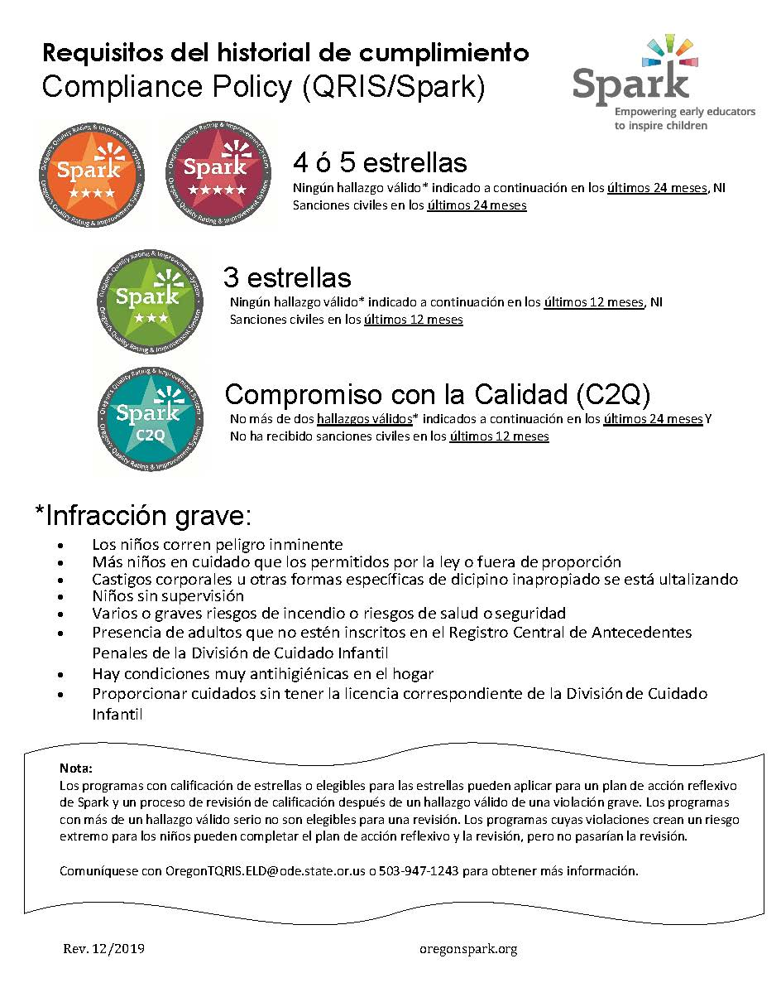
Notes:
Trainer Notes:
Here is the compliance poster

Slide 21
Solicitud para el programa
Brinda información básica acerca del programa
Identifica la persona encargo de Spark en su casa o centro
Clarifica los requisitos de C2Q
Notes:
Program Application
A. Hand out a copy of the Application if you have not already done so.
B. The purpose of the Program Application is to collect information about the program including contact information, the type of program, other general program information, information related to requirements for participating in Spark, and if the program meets C2Q requirements. The application serves as the “gateway” to the Spark process. A program must meet the minimum requirements described within the Application to be eligible to achieve a C2Q designation.
C. If there is time at the end of the training you can help the programs complete the Application.

Slide 22
Memorando de entendimiento (MOU)
Acuerdo para participar en Spark
Quédese con la primera página y devuelva solamente la página de la firma
Notes:
Memorandum of Understanding (MOU)
A. Hand out a copy of the MOU if you have not already done so.
B. The MOU contains information that programs agree to adhere to to participate in Spark.
C. If there is time at the end of the training you can have the programs read through and sign the MOU.

Slide 23
Autoevaluación
Punto de partida para Spark
Dos versiones: Centro y Familia
Herramienta para empezar a entender las normas de Spark
Reflexionar sobre sus prácticas del programa
Notes:
Self-Assessment
A. Hand out a copy of the Self-Assessment if you have not already done so.
B. The purpose and the format for the Self-Assessment
1. Part of the Spark process is to complete the Self-Assessment. This is a simplified way for programs to get an idea of how their program aligns with the Spark standards and how ready they may be to proceed in the process.
2. There are two versions of the Self-Assessment – a Center version and a Family version.
3. The Self-Assessment is taken directly from the Portfolio. If you are somewhat accurate in your assessment, you will have a good idea of your program’s readiness to proceed and what star level is attainable.
4. It is not intended to be an exact assessment. The person completing it should give their best guess or choose “partial” if they are not sure how to rate an item.
5. Programs will not be judged on where they assess themselves. The process of doing the reflection is all that is required.
6. Let the participants know that you (QIS) will be available to give them additional information on how to fill out the Self-Assessment when they are ready for this step.

Slide 24
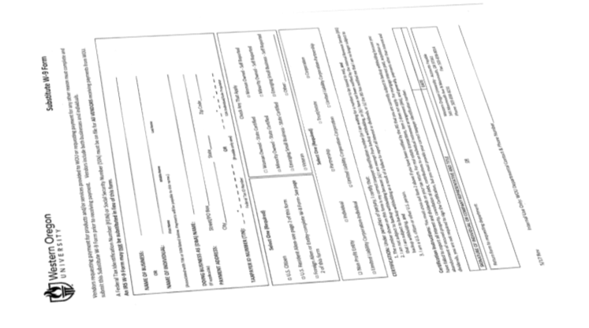
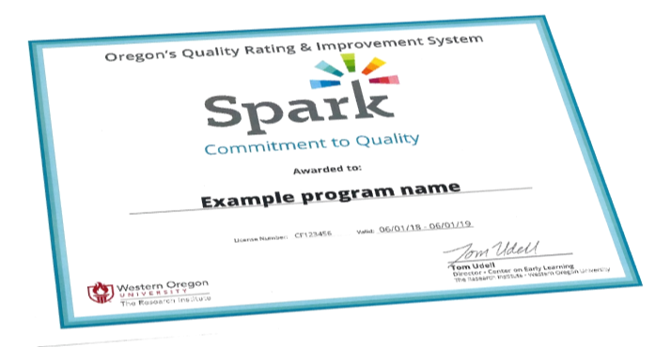
Kit de bienvenida
Notes:
Welcome Kit
A. After a program submits their completed Application and signed Memorandum of Understanding, and they pass the compliance check, they will receive their C2Q Welcome Kit.
B. Using the Example Welcome Kit quickly show them the contents.

Slide 25
Determine sus próximos pasos
USTED elige cómo proceder
No hay forma correcta o incorrecta
Notes:
Determine Your Next Steps
A. After a program completes the initial activities and they receive their Commitment to Quality designation and their Welcome Kit, they are ready to proceed on to the next part of the process.
B. Each program gets to choose how they want to go through the process.
C. There is not one right or wrong way.
D. Programs may want to go directly to obtaining a rating or may want to spend some time making improvements and get support before they get rated.
VIII. Ask participants if they have any questions about the content covered in this section.

Slide 26
Fases de la mejora de la calidad

Slide 27
Plan de Mejora de la Calidad (QIP) ¿Qué es y porqué es importante?
Guía su proceso de Spark
Incluye todos los dominios, normas e indicadores
Documenta sus necesidades de fondos de apoyo
Describe un plan para recibir apoyo del QIS
Usted elije cómo utilizarlo
QIS lo puede ayudar a completarlo
Notes:
Quality Improvement Plans – Why are they important?
The QIP is the heart and soul of Spark.
We talked in the beginning of the presentation about what each letter in QRIS stands for… “I” represents improvement, continuous quality improvement. The QIP provides a map to achieve your goals.
The QIP enables programs who have achieved the Commitment to Quality designation to take the next step in the Spark process.
Filling out and completing the QIP allows programs to not only receive financial supports, but it also enables them to indicate to their Quality Improvement Specialist what special assistance they may need to be successful during the QRIS process and beyond. So, what is the Quality Improvement Plan?
The QIP is a tool for you to use to map out your goals and accomplishments in improving the quality of your program.
QIP – What is it and why is it important?
The QIP guides your own personal QRIS process.
The QIP includes all domains, standards and indicators, but you choose how you want to use it.
The QIP documents your need for support funds.
The QIP outlines a plan for receiving supports from Quality Improvement Specialist.
Your QIS can help you fill it out when you are ready.

Slide 28
Fase de calificación de la calidad
Notes:
Quality Rating Phase
The Quality Rating Phase occurs after the program has achieved a C2Q designation and they have completed the necessary quality improvements identified in their QIP.

Slide 29
Cartera
Posibilidad de mostrar su programa
Documentar evidencia
Es necesaria para una calificación
Vuelva a enviarla tantas veces como quiera
Notes:
Completing your portfolio is your chance to show off what your program does.
Your portfolio documents your program’s quality, including quality improvements.
Completing and submitting a portfolio is required for a quality rating.
Keep in mind that ratings are never final; you can resubmit as many times as you want.

Slide 30
Evidencia
Indicador medible de la calidad de un programa
Envíe el tipo de evidencia que se pide en la cartera
Puede agregar evidencia adicional
No omita ninguna evidencia requerida
Notes:
Evidence
Your program will be asked to document your program quality against the Spark standards by submitting evidence.
The portfolio will tell you the type of evidence that you need to submit for each indicator. You may add supplemental evidence not asked for, but be sure that you submit the evidence that is required.
Types of evidence may include photographs, written descriptions, copies of program policies, and others.

Slide 31
Evidencia por tipo de programa
Notes:
Evidence by Program Type
The Spark designation is given by Office of Child Care (OCC) licensing location.
If a program has multiple classrooms at one location, certain indicators will require that items of evidence be submitted for each classroom at that location.
Multiple classrooms may include more than one classroom for an age group or different age groups (infants/toddlers/preschool/school age).
If a program has multiple licensed locations, they can choose whether to submit for Spark designation for one, some or all of the locations.
If a program will be seeking a Spark designation for multiple sites, they should contact The Research Institute for more information about portfolio requirements.

Slide 32
Proceso de desarrollo de portafolio y envío
No se olvide su manual de políticas.
Notes:
Portfolio Development and Submission Process
After you complete the Quality Improvement Plan and have deemed yourself “portfolio ready”, you will begin these steps.
Compile your evidence. Remember, if you’re going for a 4-star, you must address all 3-star and 4-star indicators. If you’re going for a 5-star, you must address every 3-star and 4-star indicator.
Place your evidence into the portfolio, hole punch it and keep it nice and organized as it is a representation of your program. Labeling your evidence and highlighting where you want the reviewer to look are very helpful practices.
Once all the information is compiled for a single indicator, check the box indicating that the evidence has been provided.
Once you have all your evidence compiled, have your QIS or a peer review your portfolio to ensure you’ve addressed all of the criteria. Then submit your portfolio to The Research Institute. Don’t forget to include your policy hand book with your portfolio.
Don’t forget to look at the scoring guide to help you understand how your portfolio will be rated.

Slide 33
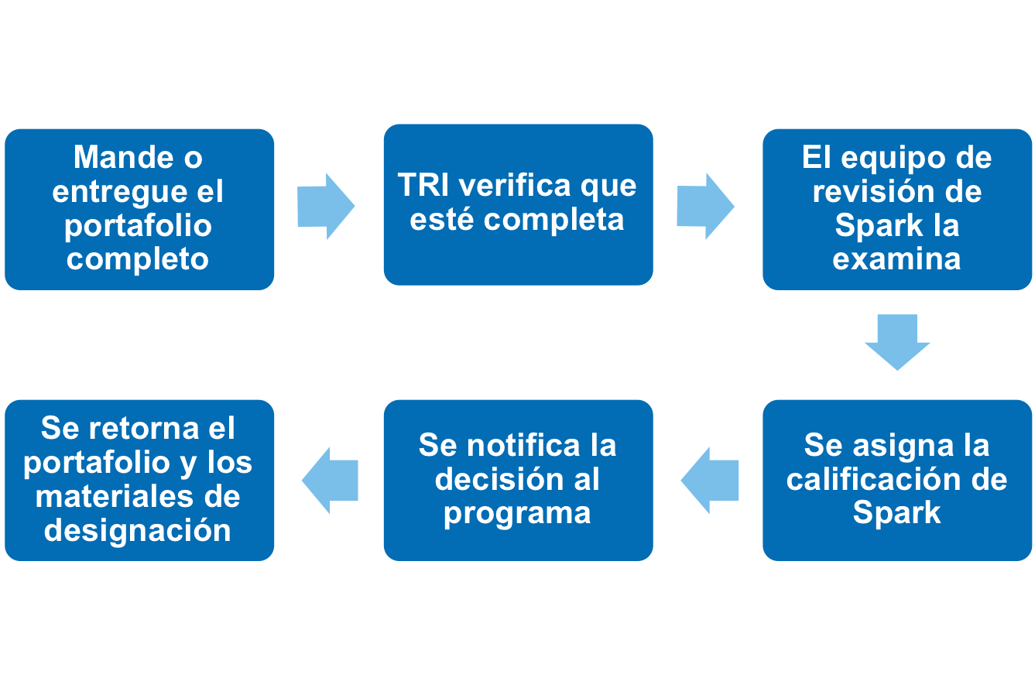
Proceso de revisión del portafolio
¡Puede reenviar el programa en cualquier momento!
Notes:
Portfolio Review Process
Portfolios can be submitted at any time and can be mailed to The Research Institute or delivered in person.
Once The Research Institute receives the portfolio, an initial screening (completeness check) is completed. If upon the initial review The Research Institute determines that your portfolio is not ready to be reviewed by the review team, your portfolio will be returned to you. Make sure before mailing it that it is complete.
Assuming the portfolio passes the completeness check, it will move onto the review team to be reviewed.
After the review, a Spark rating will be assigned and programs will then be notified of the rating.
The portfolio and designation materials will be mailed back to the program, including specific feedback.
A program can resubmit their portfolio at any time.

Slide 34
Puntuación
 | Aprendizaje y desarrollo de los niños | Salud y seguridad | Cualificaciones personales | Colaboración con las familias | Prácticas administrativas y comerciales
Cantidad total de estándares necesarios para aprobar cada dominio | 10 | 5 | 5 | 3 | 5
Cantidad total de estándares en cada dominio | 12 | 6 | 5 | 4 | 6
Notes:
Scoring
Minimum to Pass – review the requirements from the PowerPoint slide.
Portfolios that meet the criteria above will pass at the star level they are submitting for.
For example, a program must pass 10 out of the 12 standards in the Learning and Development domain.
Five out of the 6 standards in the Health and Safety domain.
100% or 5 out of the 5 standards in the Personnel Qualifications domain.
Three out the 4 standards in the Family Partnership domain.
Five out the 6 standards in the Administration and Business Practices domain.
Upon designation, programs will receive their portfolio along with a copy of their scoring guide.
Additionally, programs will also receive their designation materials (e.g., certificate indicating star level achieved, templates to help construct newsletters, window clings, etc.)

Slide 35
Fase de mejora continua de la calidad
Notes:
Continuous Quality Improvement Phase
Emphasize to the participants that program improvement does not end once they submit their portfolios and they get a quality rating. This phase of the QRIS process reinforces the importance of continuous quality improvement.

Slide 36
Luego de la revisión de la portafolio
La portafolio retorna al programa
Los programas reciben comentarios, en la hoja de resumen de puntuación, para CADA indicador intentado pero no logrado
Se emiten comentarios acerca de la organización de la portafolio
El programa envía materiales de designación si se logra una calificación de estrellas
Los programas se pueden reenviar en cualquier momento
Notes:
After Portfolio Review
Discuss the content on the slide. This slide describes what happens after a portfolio is reviewed by the Spark Review Team.

Slide 37
Reenvío de portafolios
Utilice su formulario de reenvío de portafolio como guía para el reenvío
Reenvíe evidencia solamente para los indicadores no aprobados
Puede reenviar para obtener una calificación de estrellas más alta
Notes:
Portfolio Resubmission
After you submit your portfolio and you get a rating, you should continue with program improvement.
Use your current portfolio to build on your program quality.
Resubmit evidence only for indicators that did not pass.
You can resubmit for star level initially attempted or can resubmit for higher star level using the same portfolio.
The Portfolio Resubmission form is included with the feedback; use it as a guide for resubmission.

Slide 38
Mantenimiento de la calidad
Los programas deben mantener la calidad
Los programas deben mantener los requisitos de cumplimiento
Llena el Informe de Actualización del programa (SPUR) anualmente o cuando realice cambios importantes en el programa
Notes:
Quality Maintenance
Review the points on the PowerPoint slide that address maintaining program quality.
Ask the participants if they have any questions about anything that has been covered during the training or any other questions they may have related to the QRIS.

Slide 39
Conclusión
Notes:
Introduction
During this training, we have talked about the Spark process and how programs get involved.
During this section, we are going to be talking about the following topics:
Next Steps
Resources
You have completed the first step in the Spark process by attending this Introduction to Spark Training session. Now we are going to be talking about the next steps if you decide to be involved in the Spark process.
If you are not sure that your program wants to go through the process of developing and submitting a portfolio to obtain a star rating, we would like you to consider pursuing the Commitment to Quality designation.

Slide 40
Próximos pasos
Llene la solicitud para el programa
Empieza a llenar la autoevaluación
Complete el MOU
Envíe la solicitud completa y el MOU a TRI
Luego de que TRI revise su solicitud y de completar la verificación de cumplimiento, recibirá su designación C2Q y el kit de bienvenida
Notes:
Next Steps: Application Process
A. Complete the Program Application
B. Take some time to fill out the Self-Assessment, urge participants to complete it when they return to their program
C. Complete and sign the Memorandum of Understanding (MOU)
D. Send the completed Application, Self-Assessment and MOU to TRI. Be sure to make copies and keep the originals for your records.
E. After TRI staff review your paperwork and the compliance check is completed, you will receive your Commitment to Quality designation and Welcome Kit.

Slide 41
Próximos pasos
Luego de recibir el kit de bienvenida, deberá decidir cómo quiere proseguir
Su autoevaluación, su Plan de Mejora de la Calidad y su QIS le ayudarán
Notes:
Next Steps: Welcome Kit
After you receive the Welcome Kit, you need to decide how you want to proceed: 1) stay at the Commitment to Quality level; 2) complete your portfolio without supports; or 3) request supports to support program improvement and submit your portfolio.
What you do next will depend on how you want to proceed.
If you decide to proceed with the Spark process, the next step is entering the Quality Improvement Phase. You have a choice to go directly towards working on your portfolio, or you may choose to fill out a Quality Improvement Plan and apply for financial supports. If you choose to apply for financial supports, it’s highly recommended to work with a Quality Improvement Specialist (QIS).
Spark is not only about receiving a rating, but more importantly, about continuous program improvement. Even if you decide not to participate further in Spark, you should still consider continuing to identify areas to increase the quality of your program.
We hope that you have decided/will decide to participate in Spark. Your involvement will allow you and the families you serve to celebrate and acknowledge the achievements your program has made (through your rating) as well as to provide resources and support to help with program improvements.
Ask the participants to make a commitment to start the process. Inform them of any upcoming workshops or work sessions that might help them get started.

Slide 42
Recursos disponibles
Mejora del programa:
Especialista de la Mejora de la Calidad en el centro local CCR&R
Sitio Web de recursos de QRIS de Oregon www.OregonQRISResources.org
Información acerca de la cartera, financiera y general de Spark
Especialista en Mejora de la Calidad en el centro local CCR&R
El instituto de investigaciones:
Línea de ayuda de Spark: 1-877-768-8290
Correo electrónico: QRIShelp@wou.edu
Sitio Web: triwou.org/spark
Notes:
Resources Available:
As you work through the Spark process or if you have questions about Spark, remember that you have a number of resources available to help you.
1. For questions or help and for resources related to program improvement you can contact your Quality Improvement Specialist, the CCR&R ORO specialist, or access the Oregon’s Spark Resources website.
2. For questions related to completing your portfolio you should contact TRI at Western Oregon University. Their toll free helpline number is 877-768-8290 or e-mail qrishelp@wou.edu
3. The Spark website (triwou.org/spark) also has general information. There is a FAQ page on the website that answers common questions.
. Reflective Activity (optional)
One suggestion is to revisit the Comfort Zone activity. If short on time, you can ask the same question as in Section 1 to the whole group and have participants volunteer to share their thoughts.

Slide 43
¡Gracias!
Notes:
Closing
Announce that this is the closing section and describe the activities:
This section will take about 10 minutes.
Inform participants that they will complete an evaluation to give us feedback on this workshop.
Explain that certificates will be issued at the close of the workshop.
Workshop evaluation
Explain that we evaluate our training so we can be sure it is helpful to our participants.
Encourage participants to let us know what portions of the training were particularly useful for them and to also let us know what could be improved upon and how.
Remind participants they do not have to put their name on the evaluation.
Have participants complete their evaluation forms and turn them in to you.
Certificates
Thank participants for their participation and hand them their certificates. Note that the number of hours of the workshop is on the certificate. Also let them know that they should file it along with their objectives since they can be used to document contact hours for the Oregon Registry to move up on Registry Steps and the Office of Child Care for licensing requirements.
Invite participants to contact you if they have any questions and remind them that there is a lot of support available for the Spark process

