Slide 1
Pre-Employment Transition Services (Pre-ETS)
Supportive services for students and educators
Provided by Vocational Rehabilitation

Slide 2
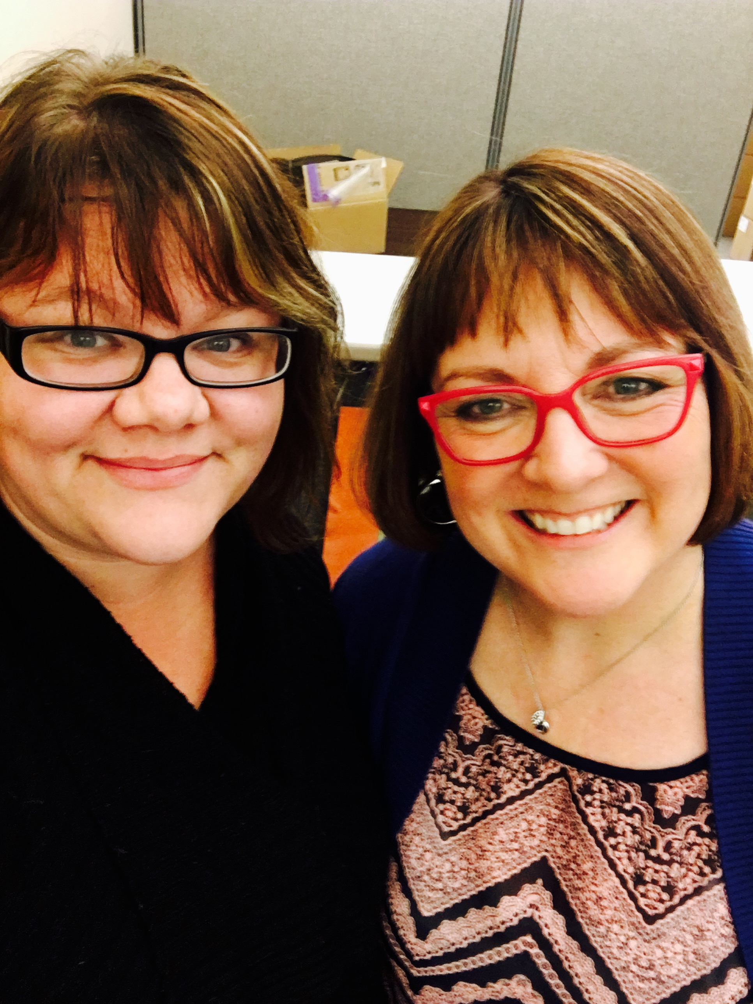
Who are we?
Toni Depeel, GCDF
Pre-ETS Coordinator
Nationally Certified Global Career Development Facilitator who is a 19 year veteran Transition Specialist under the State of Oregon Vocational Rehabilitation/YTP Grant.
Nicole Perdue, MS, CRC
Pre-ETS Coordinator
Graduate of the Clinical Rehabilitation Masters program at Portland State University. New to the VR world but has spent the past few years partnering with school districts in the Portland metro area in supporting their students with finding and sustaining employment.

Slide 3
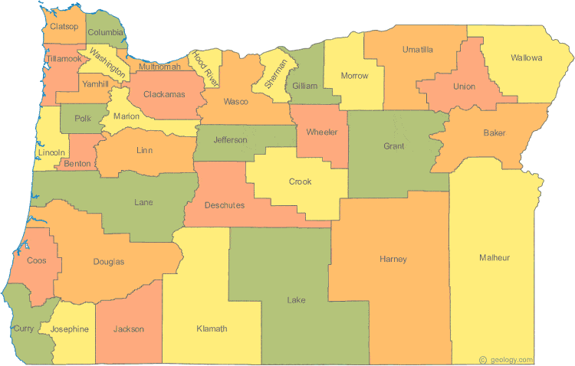
Portland Metro and surrounding:
Toni Depeel
Pre-ETS Program Coordinator/ Willamette Valley: CJ Webb
Central & Eastern Oregon:
Nicole Perdue
Eastern TNF/Pre-ETS Support: Donna Lowry
Southern TNF/ Pre-ETS Support: Joy Ward

Slide 4
A brief history of Pre-ETS

Slide 5
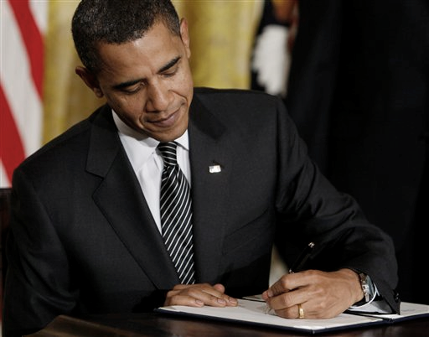
Workforce Innovation and Opportunity Act (WIOA)
Signed in to law July 22nd 2014
Intended to increase opportunities for the American work force as a whole
Pairs with the I.D.E.A.

Slide 6
WIOA meets IDEA
IDEA
To ensure that all children with disabilities have available to them a free and appropriate public education that emphasizes special education and related services designed to meet their unique needs and prepare them for further education, employment, and independent living.
34 C.F.R. §300.1
WIOA
To increase, for individuals in the United States, particularly those individuals with barriers to employment, access to and opportunities for the employment, education, training, and support services they need to succeed in the labor market.
P. L. 113-128
IDEA
“Nothing within WIOA is to be construed as reducing the responsibility of the local educational agencies or any other agencies under the Individuals with Disabilities Education Act to provide or pay for transition services that are also considered to be special education or related services necessary for the provision of a free appropriate public education to children with disabilities.”
W
IO
A

Slide 7
WIOA and VR
In collaboration with the local educational agencies involved, [VR] shall provide, or arrange for the provision of, pre-employment transition services for all students with disabilities in need of such services who are eligible or potentially eligible for services under this title.

Slide 8
How we work

Slide 9
Transition Network
VR Pre-ETS coordinators
April 2017
ODDS Regional
Employment Specialists
October 2015
Regional Employment and Training Coordinators (added to TNF team)
July 2015
Transition Network
Facilitators
(TNF)
August 2014
VR/IDD Counselors hired
June 2013

Slide 10
YTP VS. Pre-ETS Coordinators
YTP
Pre-ETS Coordinators
YTP
Pre-ETS
Provides Pre-ETS
Manages a case load of students year round within district
Creates and sustains programs in individual schools
Funded by VR and local school district (can only serve students in specific districts or ESDs)
Work closely with Pre-ETS coordinators
Provides Pre-ETS
Assists students as needed on case by case bases, statewide
Supports and provide resources to educators and students
Funded by VR (considered a VR service) can serve any student potential eligible
Work closely with YTP professionals

Slide 11
How We Help
Teach classes
Provide career counseling (individual/group)
Coordinate services
Provide trainings
Provide curriculum
Support transition program growth or development
Educate, inform, train
And much more

Slide 12
Our mission:

Slide 13
Transition Book Pre-ETS Resources

Slide 14
Pre-Employment Transition Services (Pre-ETS)
Pre-ETS
Pre-Employment Transition Services (Pre-ETS) are supportive services offered by vocational rehabilitation to enhance transition opportunities for students.
Services need to be requested by the student, and must fall under at least one of these categories:
Self advocacy
Workplace readiness
Work based learning
Job exploration counseling
Counseling on post-secondary or transition opportunities

Slide 15
Job Exploration Counseling
Transition Handbook examples
Histogram
Career Jeopardy Game
Career Interest Survey/Inventories
Sprout Films
Project access
Where are you going

Slide 16
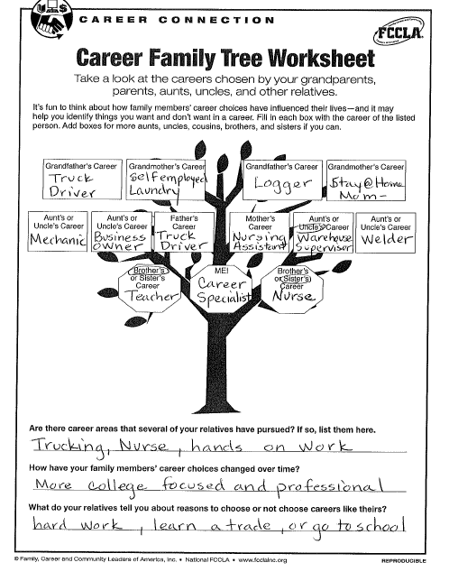
Histogram
How does a family work History relate to a student’s interests?
Are there Patterns?
Are there Changes?
What reason do you have to work?
Http://tripod.org/projects/tcn/topicspage/854/career-family-tree

Slide 17
Work Based Learning Experience
Transition Handbook examples
How to Guide for Job Shadows
Child Labor Law Summary- Oregon Bureau of Child Labor Laws
Eastern Oregon Regional Job Club Materials
Career and Technical Education
Implementation of Work-based learning model

Slide 18
How to Guide for Job Shadows
http://www.newwaystowork.org/qwbl/tools/kcktoolkit/Guides/How_To_Guide_Job_Shadows.PDF​

Slide 19
Counseling on Opportunities for Post Secondary Education and Transition Services
Transition Handbook examples
Going to College
College vs High School
Think College
Disability 411
Post Secondary Education
College planning for students with disabilities

Slide 20
Going to College
http://www.going-to-college.org/​

Slide 21
Workplace Readiness Training
Transition Handbook examples
Skills that pay the bills
Keeping a job
Project Access: Career Options Student Interview
Social Behavior Mapping
Name of Activity: Planning My Way to Work

Slide 22
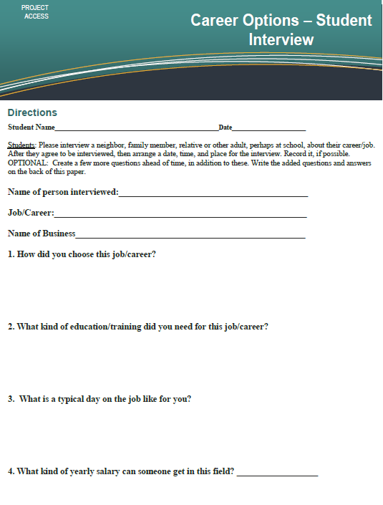
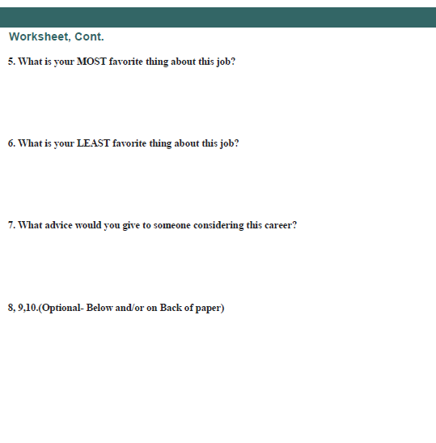
Project Access Curriculum
http://projectaccess.uoregon.edu/lessonplans/careeroptions.html​

Slide 23
Introduction to Self-Advocacy- Ideas
Transition Handbook examples
ME! Lessons for Teaching Self-Awareness
Learn About Self-Advocacy: Speaking Up!
Back to Youthhood
In the Driver’s Seat: Six Workshops to Help with Transition Planning and Self- Advocacy
It’s my Choice/Moving Students Forward
Dude Where’s My Transition Plan”
Stories from Self-Advocates
Speak Up! Using What You’ve Got to Get What You Want

Slide 24
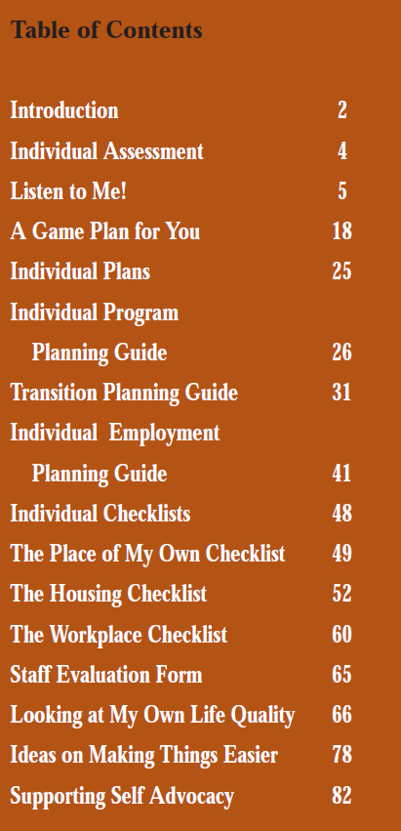
It’s my Choice/Moving Students Forward
https://movingstudentsforward.org/its-my-choice-workbook-from-mn-governors-council-on-developmental-disabilities/

Slide 25
What to do when you hit a Pre-ETS roadblock

Slide 26
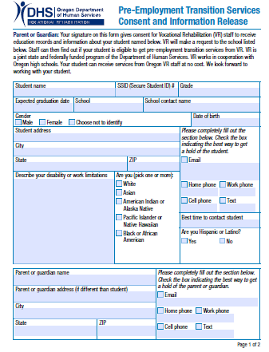
Requesting Services
Access form online
Paper Copies available from Pre-ETS coordinators
Connect with us via Email to request form
Ask for a form in Person!
Return Form to a Pre-ETS coordinator
Submit via Email
Or send to VR Portland Central office

Slide 27
Independent Living
Paid job in community
Long term service connections
Student to adult transition
Transition Programs
College
High School
Educators
YTP
Pre-ETS
Job Development
Vocational Rehabilitation
Friends and family
DD Services
Community Members
Community

Slide 28
Questions?

Slide 29
Toni DePeel Pre-ETS Coordinator Email: Toni.M.DePeel@dhsoha.state.or.us Phone: 971-600-8358
Nicole Perdue
Pre-ETS Coordinator
Email:
Nicole.j.Perdue@dhsoha.state.or.us
Phone: 971-718-4054

