Slide 1
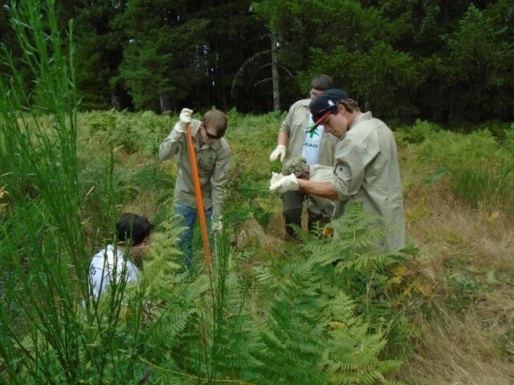
WAGES: How to put them in your pocket
A Presentation by
Josh Barbour
Ken Woody
Mike Johnson
Oregon State Transition Conference
March 1-2, 2018
Portland Marriott Hotel

Slide 2
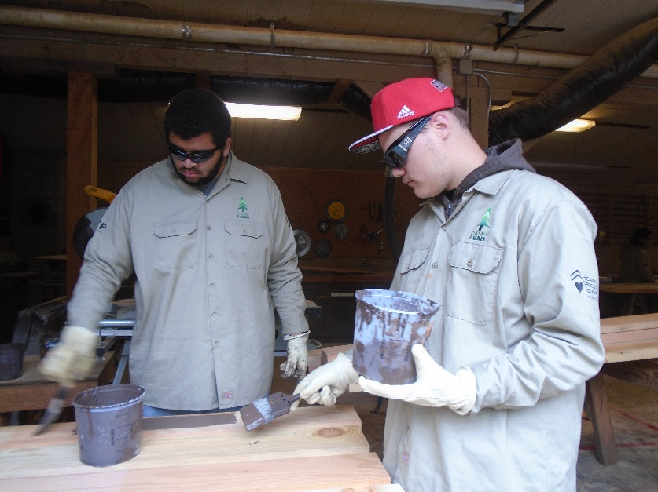
What Students Had to Say:
“I never thought there would be a class like this in high school – that you could actually use. I haven’t been in the principal’s office in two months.”
“I love this class – it has been the most impactive class – I don’t get mad at teachers and I learned how to listen and not react.”

Slide 3
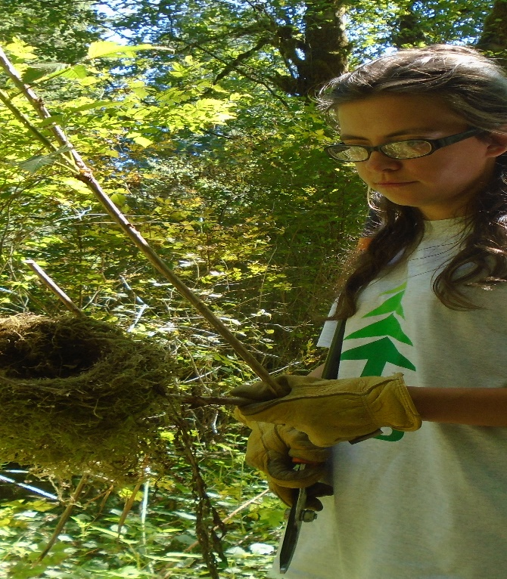
“I liked the connection with horticulture. Teamwork and communication skills have helped a lot.”
“The class taught me self-control and responsibility.”

Slide 4
W.A.G.E.S.
Guiding Principles
Address real life social interactions
Genuine assessment of social skills
Best taught in the context of work
Key elements of effective instruction
Address career-related learning requirements
Supports the delivery of Pre-Employment Transition Services (Pre-ETS)

Slide 5
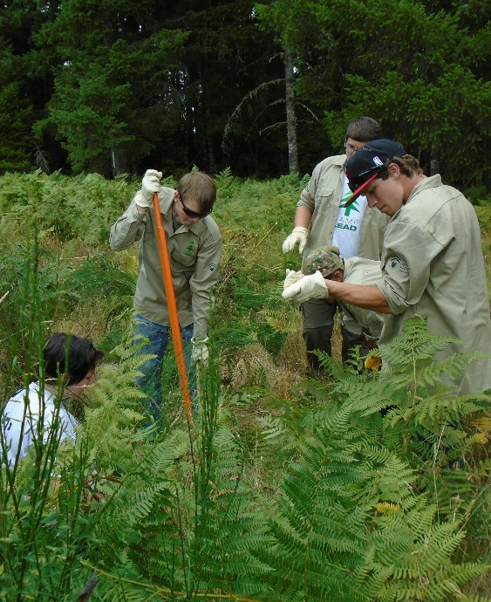
W.A.G.E.S.
FOUNDATION SKILLS
LOCUS OF CONTROL
TEAMWORK
COMMUNICATION
PROBLEM-SOLVING
Notes:
Mike J takes over: After viewing another portion of STRIVE; might even want to use their list of generated qualities to place within these domains.

Slide 6
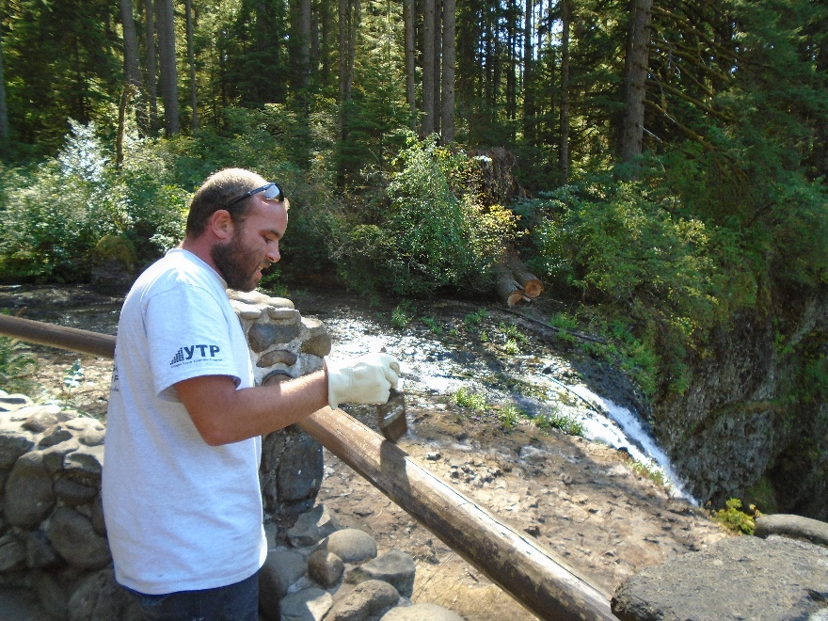
ATTITUDES
W.A.G.E.S.
ENTHUSIASM- Smile
DEPENDABILITY-Just Show Up
HONESTY- Don’t Lie, Cheat, or Steal

Slide 7
Lesson Format
Statement of Learning Outcomes
Review
Description of Required Materials
Vocabulary
Description of the Activity
Wrap-up/Homework

Slide 8
Using the Instructors Guide
Simple Overview of Scope and Sequence
Complementary Activities – Pre-ETS
Teaching Tips

Slide 9
WAGES Scope and Sequence
Section | Lesson | Complementary Activities | Lesson Title | Assessments
Unit One | 1 | Career Guidance Activities Interest Inventories Career Aptitude Assessments Job Matching (1 - 2 Days) | Getting The Ball Rolling
 | 2 |  | W.A.G.E.S. Program Overview
Unit Two Locus of Control | 3 |  | Locus of Control = Responsibility
 | 4 |  | What Does Locus of Control Mean To The Team?
 | 5 |  | What Does Locus of Control Mean To The Team? Part 2
 | 6 |  | Self-Control
 | 7 |  | Self-Control Part 2
 | 8 |  | Making More W.A.G.E.S. | #1 Mastery Vocab Test

Slide 10
Section | Lesson | Complementary Activities | Lesson Title | Assessments
Unit Three Teamwork | 9 |  | Teamwork
 | 10 |  | Good Values Are Out Of This World!
 | 11 |  | What’s In The Bag?
 | 12 |  | What’s In A Team?
 | 13 |  | Practice Makes Perfect | Mastery Vocab Test

Slide 11
Section | Lesson | Complementary Activities | Lesson Title | Assessments
Unit Four C O M M U N I C A T I O N | 14 | Resume Cover Letter Letter of Appreciation Employer Mock Interviews (5 - 6 Days) | Did I Hear You Right?
 | 15 |  | Communication Breakdown
 | 16 |  | Could You Repeat That?
 | 17 |  | Accepting Criticism
 | 18 |  | Communicating With Power
 | 19 |  | Communicating With Self-Control
 | 20 |  | Enthusiasm
 | 21 |  | Peer Interviews Orientation
 | 22 |  | Interviews With Peer Ratings Part 1
 | 23 |  | Interviews With Peer Ratings Part 2
 | 24 |  | Interviews With Peer Ratings Part 3 | Mastery Vocab Test

Slide 12
Section | Lesson | Complementary Activities | Lesson Title | Assessments
Unit Five P R O B L E M - S O L V I N G | 25 | Job Shadow Industry Tour | How Do I Solve the Problem? | Problem-Solving Pre-Test
 | 26 |  | Let’s Solve Some Of Our Own Problems
 | 27 |  | Dependability
 | 28 |  | Honor Role
 | 29 |  | The Whole Is Greater Than the Sum of Its Parts
 | 30 |  | Creative RADD
 | 31 |  | Making More W.A.G.E.S. Again
 | 32 |  | Let’s RADD Our Problems (Part 1)
 | 33 |  | Let’s RADD Our Problems (Part 2) | Mastery Vocab Test Problem-Solving Post Test

Slide 13
Pre-Employment Transition Services
Job Exploration and Counseling
Work Based Learning
Counseling for Post-Secondary Goals
Workplace Readiness
Self-Advocacy

Slide 14
Activity | Days | Rationale | What Works Best?
Career Guidance | 1 - 2 | Provides a career focus and a vocational context for the course of study. | Utilize the school’s Career Center to help students gain awareness of the types of careers in which they may be interested. Use of the internet may also provide interest inventories and career matching that allow for a career focus.
Resume Development | 1 | Demonstrates career focus and markets students’ strengths, abilities, and interests. Pre-requisite for the Employer Mock Interview. | Most high schools have canned resume programs that can be useful in designing a resume. The internet and some word processing programs may also have resume templates that will be helpful.
Cover Letter | 1 | Introduces each student’s interest in a particular career field | Utilize high school computer lab to compose a form letter.
Letter of Appreciation | 1 | Provides students with an opportunity to thank community patrons who may participate in the employer mock interview for their time. | Utilize high school computer lab to compose a form letter. Have students ask for the business card of the employer who interviews them.
Employer Mock Interview | 2 - 3 | Provides a realistic interview where students can demonstrate skills learned during the communication unit. | Work with other school staff to host a major event that brings community businesses into the learning environment.
Job Shadow Industry Tour | 1 | Allows students to discern the relationship between the employment skills taught in the curriculum and the workplace. Provides additional opportunity for students to demonstrate their communication skills. | Reward students for engaging in this career exploration activity on their own time.

Slide 15
W.A.G.E.S.
Let’s try some lessons…
Notes:
**Before beginning Lessons #2, 3&4, 9, and 25 have participants reflect on scope and sequence **Also mention the Teacher Tips portion of the Instructor’s Guide

Slide 16
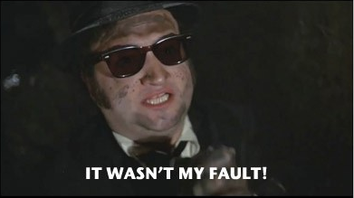
Locus of Control
https://www.youtube.com/watch?v=4U9Yl5CXvcQ
Notes:
This is where Josh comes in…so you don’t have to stay with this slide if it doesn’t fit your needs
“Do everything without grumbling or questioning” Philippians 2:14

Slide 17
Locus of Control
Locus of Control: The “location of an individual’s sense of personal control or responsibility over actions and events.
Internal Locus of Control: A measure that determines how much self control a person has for his/her own behavior. This is known as Owning.
External Locus of Control: A measure of how little self-control and responsibility a person has for his/her own behavior. This is known as Moaning.
Notes:
This is where Josh comes in…so you don’t have to stay with this slide if it doesn’t fit your needs
“Do everything without grumbling or questioning” Philippians 2:14

Slide 18
Locus of Control
Why is Teaching Locus of Control Important?
Identifies Student Responsibility and Begins Teaching Strategy for Self Control
Provides Vocabulary for Problem Solving
Meets the Workplace Readiness Training and Instruction in Self-Advocacy Pre-ETS.
Notes:
This is where Josh comes in…so you don’t have to stay with this slide if it doesn’t fit your needs
“Do everything without grumbling or questioning” Philippians 2:14

Slide 19
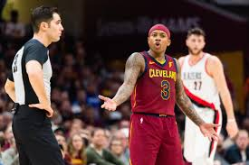
Locus of Control
Is Isaiah Thomas Owning or Moaning? https://www.youtube.com/watch?v=X77GTech3Oo
Notes:
This is where Josh comes in…so you don’t have to stay with this slide if it doesn’t fit your needs
“Do everything without grumbling or questioning” Philippians 2:14

Slide 20
Lesson #9 Guidelines
Each member must be at the end of string
Cannot wrap string or use two hands
Team members clean up spilled beans
Team members switch places each time
Total elapsed time to accomplish three tasks
Penalize per beans spilled
Notes:
This is where I come back in to do Lesson 9

Slide 21
Collaborative Problem Solving (CPS) “getting to the cerebral cortex for learning”
Sequence of Engagement with students:
1. Regulate
2. Relate
3. Reason
Notes:
I like the simplicity of these RRRs

Slide 22
How are we going to inspire this learning?
Behavior change—what is it?
It’s Brain change—the formation of new connections and associations that create a new pathway up which signals travel when it receives a certain stimulus
Notes:
Okay

Slide 23
Behavior Change is Brain Change
Occurs when we receive enough repetitions of signals activating and traveling a new pathway for that pathway to become the “default pathway” the pathway that signals automatically travel at speeds that surpass our ability to measure.
This is why “relevant repetition” is so important in students’ learning of WAGES
Notes:
Okay

Slide 24
Correct! The dumbest part of the brain:
Where does unregulated information go?
EMPATHY leads to Regulation, the key that enables the student to learn!
Notes:
I especially like the Empathy leads to Regulation…coincides with communication lesson…yet don’t need first two bullets

Slide 25
Carl Rogers—Student-Centered Relationships
Unconditional Positive Regard
Accepts the student for who she/he is and provide support and care no matter what she/he is going through
Congruence
Teacher is comfortable sharing feelings, provides model for communication—it’s okay to be vulnerable
Empathetic Understanding
Forms positive learning relationship, acts as mirror, reflecting student’s thoughts and feelings back to him or her; allowing the student to better understand him or herself
Notes:
I especially like this description of how important connection to the student is

Slide 26
A successful “dose” to the brain:
Relational—safe
Relevant-developmentally and environmentally match, students see the need and desirability to learn
Repetitive—predictable
Rewarding—pleasurable
Respectful—child, family, culture
Notes:
Reinforces positive facilitation of the curriculum

Slide 27
A successful CPS intervention:
Empathizes (with student’s concern)—leads to regulation, the key to their cortex!
Shares the adult concern—the student-teacher relationship leads to a relationship where both work together to make the most of the learning opportunities
Collaboration is possible when there is empathy, students can regulate; the result is Reason, Learning
Notes:
Good teaching model!

