Slide 1
Inclusion in Action: Strategies for Supporting Young Children with Autism Spectrum Disorder and Their Families
Gary Glasenapp
The Research Institute
Western Oregon University
glaseng@wou.edu
Notes:
Before you do the training, add the presenter information to the title slide. This might include the name(s) of the trainers/presenters, their agency, and contact information such as email address.
You will need the following materials for this workshop:
Computer
Projector
Screen
Chart pad/chart paper
Markers
Index cards
Handouts
Before participants arrive, place the materials on the tables (copies of PowerPoint slides, agenda, workshop evaluation, the handout on Pervasive Developmental Disorders, and the handout on Oregon ASD eligibility requirements)
Welcome the participants to the training. State the name of the session.

Slide 2
Getting to Know You….
Community preschool/ center-based child care provider
Family provider
Head Start
Home visitor
Director/administrator/ supervisor
Teacher
Assistant teacher/ paraeducator
Have or had a child with ASD in your program
Notes:
Do the Getting to Know You activity.
As you show and read out the different bullet points, have the participants either raise their hands or stand up if the description applies to them. Then have them lower their hand or sit down. Let them know that they can raise their hands/stand up several times depending on their role (for example, they work at a Head Start program and they are a teacher).
The purpose of this activity is to give the presenters a general idea of who the participants are if they do not already know them.

Slide 3

Activity
Form a line based on the number of years of experience you have in working with children with ASD.
  Fold together… Share one strategy you have used.
Line up again based on how comfortable you feel working with children with ASD (on a scale of 1-10).
  Fold together again… Share why you gave yourself the number.
Notes:
This activity is designed to give the trainers/presenters an idea of the participant’s experience, if any, in working with children with ASD.
There are two parts to this activity. Have them do the first part (line up based on the number of years you have in working with children with ASD). Then have them line up again and do the second part (how comfortable they feel in working with children with ASD – a 1 means that they are extremely uncomfortable, a 10 means that they are very comfortable).

Slide 4

Session Objectives
Examine characteristics of ASD and the impact on learning and development.
Implement strategies for helping young children with ASD function in preschool and child care settings.
Implement strategies for communicating and collaborating with parents of children with ASD.
Notes:
This workshop has 3 objectives.
Briefly review the session objectives from the slide.

Slide 5

Agenda and Materials
Notes:
Review the handout of the session agenda. Let them know that this is a 3-hour training and the agenda outlines the order of the topics that will be covered. There will be a formal break about half way through the session.
Explain the materials – handouts that include copies of PowerPoint slides, agenda, workshop evaluation, the handout on Pervasive Developmental Disorders, and the handout on Oregon ASD eligibility requirements.

Slide 6

Rate your understanding of ASD on a scale of 1 to 5.
Notes:
Before you get into the content of the workshop, have them do one more introductory activity.
Have participants respond to the statement on the PP slide by holding up 1 to 5 fingers (1 finger means that they know nothing about ASD, 5 fingers means that they believe that they have a very good understanding of ASD) in response to the statement on the slide.
This should give you (presenter/trainer) additional insight into the participant’s initial understanding of ASD.

Slide 7
Characteristics of ASD and the Impact on Learning
and Development
Notes:
The first topic that will be covered is the characteristics of ASD and how these impact the child’s learning and development.

Slide 8


Activity
In a small group, write down 3 characteristics of children with ASD.
Also write down how these characteristics affect learning and development.
Notes:
Have the participants get into small groups of 3-5 (depending on the number of participants). Hand each group two index cards.
On one of the cards, have them as a group write down at least 3 characteristics of children with ASD.
Once they have completed this, on the second card, have them write down how these characteristics affect the child’s learning and development.
Ask for a volunteer from each group to share what their group came up with, first the characteristics, then how these affect learning and development.

Slide 9
What is ASD?
Life long developmental disability.
Central nervous system dysfunction.
Presents challenges with:
  Social interactions
  Communication
  Behavior
Affects understanding and using language and interactions with people and events.
Affects understanding and responding to things child sees, hears, touches, tastes and smells.
Considered a "spectrum disorder."
Notes:
Discuss the points on the slide:
ASD is a life long developmental disability. This means that this disability impacts the person’s development and cannot be cured. While it cannot be cured, we can help the child lessen the effects of the disability and equip them with skills to cope with the disability.
ASD affects the central nervous system – something in the brain does not develop normally.
When we talk about ASD we often look at the disorder in presenting challenges in three primary areas:
Social interactions – children often have difficulty in interacting with their peers and adults.
Communication – children with ASD often have difficulty in communicating. Children with ASD may not speak at all or have limited communication skills.
Behavior – children with ASD often have behavioral challenges.
We will talk about these challenges in more detail in a few minutes.
As stated earlier, ASD affects a child’s understanding and using language and interactions with people and events.
ASD also affects a child’s response to things they see, hear, touches and smell.
A “spectrum disorder” means that there may be a wide range of symptoms, skills and levels of disability. (Not every child with ASD is the same)

Slide 10
Pervasive Developmental Disorders
(Autism Spectrum Disorders)
PDD/ ASD
Autistic Disorder
Asperger’s Disorder
PDD-NOS
Childhood Disintegrative Disorder
Rett’s Syndrome
Notes:
As we said in the earlier slide, ASD is considered a “spectrum disorder.” Pervasive Developmental Disorders refers to a group of 5 disorders characterized by delays in the development of multiple basic functions including socialization and communication. These 5 disorders make up what is typically called “Autism Spectrum Disorders.”
Refer the participants to the handout on PDD and very briefly review the key points.

Slide 11
What Causes ASD?
No known single cause.
Usually the cause for individual cases is unknown.
Anything that could cause a central nervous dysfunction could be a possible cause.
Notes:
What about the causes of ASD? We are going to take the next few minutes and talk about what causes ASD.
We know that there is no single cause of ASD. It is believed that there are a number of factors that contribute to causing ASD.
We also know that usually the cause for individual cases in not known.
We know that anything that causes a central nervous dysfunction could be a possible cause of ASD.

Slide 12
Possible Causes of ASD
Genetics
Metabolic imbalances (chemical processes)
Viral infections
Pre, peri or post natal trauma
Environmental toxins
Notes:
More specifically, there are several theories or possible causes of ASD. These include:
Genetics – there is some evidence that ASD may have genetic factors as ASD may run in families (this does not mean that all children in the family will have ASD). Most researchers believe that certain genes a child inherits from their parents could make them more vulnerable to ASD. No specific genes have been linked to ASD.
Metabolic imbalance – there is some evidence that ASD may be caused by imbalances in the chemicals or the chemical processes in the brain.
Viral infections – some researchers suggest that viral infections, particularly those that directly impact the brain may also contribute to ASD.
Trauma to the child that happens before birth (prenatal exposure to alcohol or medications), during birth (perinatal), or after birth (postnatal) or premature birth are also possible causes of ASD.
Toxins in the environment, such as pesticides or other chemicals, are also theorized to be possible causes of ASD.

Slide 13

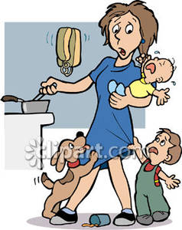

What DOESN’T Cause ASD?
Notes:
Researchers have also identified some factors that do NOT cause ASD. These include:
Child vaccinations
Poor diet or eating certain foods
Poor parenting

Slide 14
What is the Prevalence of ASD?
One in 45/50/68 U.S. children has ASD. (Oregon has the second highest rate in U.S. for children ages 6-17).
5 times more boys than girls.
3.5 million Americans today are believed to have some form of autism.
67 children are diagnosed per day.
A new case is diagnosed every 20 minutes.
More children will be diagnosed with ASD this year than with AIDS, diabetes & cancer combined.
Notes:
So, how prevalent is ASD? While these statistics change on an ongoing basis, here are some statistics that show that ASD is fairly common, especially in relation to other disabilities (go over the statistics on the slide).
We know that the prevalence of ASD has increased in the last several years. There has been several suggested explanations for this increase:
The definition of autism has been expanded to cover ASD, not just Autism Disorder, therefore more children have been identified.
There is more awareness of ASD, so we are doing a better job of identifying children.
There are more children who have ASD.

Slide 15

Medical Diagnoses
No medical tests for diagnosing.
Diagnosis is based on the Diagnostic and Statistical Manual of the American Psychiatric Association (DSM-5).
Identifies behaviors the child displays that lead to a diagnosis.
Diagnosis must be based on observation of individual's communication, behavior and developmental levels.
Notes:
When we talk about determining a diagnosis of ASD, we need to be aware that there is no medical test that a doctor can do on a child to determine that a child has ASD.
Instead, the diagnosis is based on characteristic that are included in the Diagnostic and Statistical Manual of the American Psychiatric Association (DSM-5). This manual lists behaviors that a child may display. If a child displays a number of these behaviors they may be diagnosed as having ASD.
The diagnosis is based on an observation of the child’s communication and behavior skills and their developmental level.
Typically, a multidisciplinary team (representing medical, communication, behavioral, and other perspectives) determine the actual diagnosis.

Slide 16
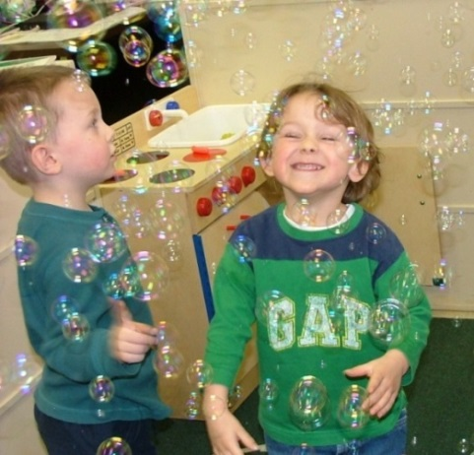
Educational Eligibility
Educational eligibility is identified through behavioral characteristics as outlined by State of Oregon requirements (see handout).
Notes:
Oregon, as do other states, has identified requirement to qualify for education services in the ASD category.
Refer the participants to the Oregon ASD eligibility requirements handout.

Slide 17
Early Recognition of ASD
Can reliably be diagnosed at 18 months.
Researchers are pursuing methods for detecting warning signs in children even younger, in some cases as young as 12 months.
Notes:
While early recognition is important, ASD cannot be reliably diagnosed until the child is about 18 months of age.
However, researchers are pursuing methods for detecting warning signs in children even younger, in some cases as young as 12 months.

Slide 18
Early Warning Signs
Lack of pre-verbal gestural communication (pointing or gestures).
Lack of joint attention and eye contact.
Lack of smiling.
No single words by 16 months.
Loss of language or social skills at any age.
Obsessive interest in certain objects, activities, or parts of objects.
Unusual responses to sensory information.
Notes:
While a reliable diagnosis for ASD is not available until the child reaches about 18 months, there are a number of warning signs that you should be aware of.
Review the points on the slide.

Slide 19
What do Autism Spectrum Disorders Look Like?
Notes:
In this section, we are going to talk more in-depth about ASD.

Slide 20
How Might a Child with ASD Behave in an Early Childhood Program?
Communication and behavior difficulties.
Obsession with specific objects and/or topics.
Challenges with fine motor activities.
Prolonged interest in common occurrences.
Difficulty with social cues.
Adherence to rituals/repetitive behaviors.
Difficulty with context.
Notes:
Ask the participants, based on what we have talked about so far, how a child with ASD might behave in an early childhood program? (Do this before you show them the points on the slide). You can write their responses on chart paper if you want.
Add to their responses by reviewing the points on the slide.

Slide 21
Communication Characteristics
Limited or no speech and/or lack the typical communicative gestures.
For those who have speech, may have unusual speech patterns and repetitive phrases, questions and topics.
May revert to use of nonverbal behaviors when confused or anxious.
May speak in complete sentences but not be able to carry on or maintain interactive conversation.
May use repetitive/stereotypic sounds or repeat certain questions over and over which makes him seem non-communicative.
Notes:
At the beginning of the workshop, we said that one of the major identifying characteristics of children with ASD is communication difficulties. Some communication characteristics of children with ASD are listed on the slide.
Review the points on the slide.

Slide 22
Communication Characteristics
Echolalia.
Reverse pronouns.
Difficulty understanding instructions or language out of context.
Understanding and use of language may be very literal and concrete.
Notes:
Echolalia means that the child repeats a word or phrase over and over. These may be single words or a phrase (like a common phrase from a TV show).
Unusual voice quality means things such as having a high voice pitch, an unusually quiet or loud voice, or a different voice tone.
Reversing pronouns means that the child may refer to a boy as “she” or a girl as “he.”
Children with ASD often have difficulty understanding instructions or language out of context.
Finally, children with ASD may have difficulty understanding abstract concepts. They also tend to use and understand language literally.

Slide 23
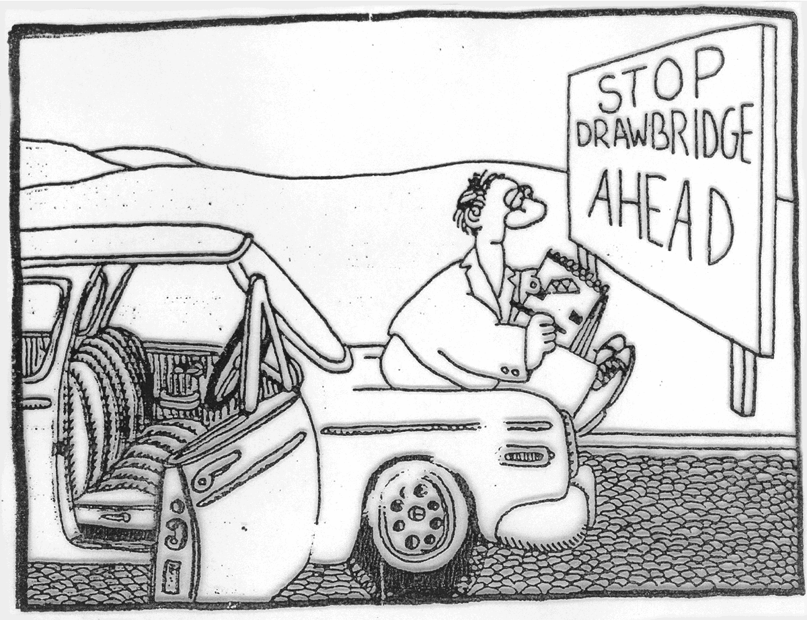
Notes:
This cartoon illustrates the idea that children with ASD tend to take things literally so we need to be very careful how we word things.

Slide 24
Social Interactions
Seem to lack the ability to initiate social interactions or maintain conversations or games.
Show fear of strangers or new activities and materials by avoiding or resisting contact or by coming too close to explore by touching, smelling or staring.
Cling to people and seek physical contact or may be unusually sensitive to touch (especially light touch).
Poor eye contact and limited play and social interactions.
Notes:
A second major identifying characteristic of children with ASD is difficulties with social interactions with their peers and other adults.
Review the points on the slide.

Slide 25
Social Interactions
Frequently prefers to be alone.
Display a complete lack of interest in peers.
Difficulty understanding social cues - such as facial expressions, body language and the feelings of other people.
Play often will not include interacting with peers and sharing toys.
Play may be limited to functional play and lack imaginative components.
Notes:
Continue to review the points on the slide.

Slide 26
Cognitive Characteristics
Selective attention.
Often focus on details and are unable to see the whole.
Concrete processing.
Rote memory.
Difficulty generalizing.
Have a difficult time understanding abstract concepts such as clean and dirty.
Have trouble with beginnings and endings.
May have a very limited number of interests and activities.
Notes:
Another characteristic of children with ASD is cognitive challenges.
Review the points from the slide.

Slide 27
Restrictive, Repetitive, or Stereotypical Behaviors
Play repetitively with objects or toys and may not use them for intended purposes.
Develop a strong attraction to certain object, routines, and rituals.
Show anxiety about certain events and schedules.
Drift randomly from place to place or object to object with no apparent purpose.
Difficulty with changes in the environment, schedules and the people around them.
Notes:
Children with ASD may also display restrictive, repetitive, or stereotypical behaviors. Stereotypical behaviors are repetitive or ritualistic behaviors such as rocking or arm flapping.
Review the points from the slide. You may need to add more specific examples for some of the items.

Slide 28
Sensory Issues
Extreme over reaction or under reaction to sensory stimulation.
Unusually sensitive to environmental conditions and unable to screen out irrelevant stimuli.
Ability to attend and respond may vary from day to day.
Notes:
Children with ASD often experience sensory issues. This may include over or under reaction or response to sensory stimulation (such as screaming when they are touched or when they hear a loud sound or not responding at all when they hear a loud sound).
Children with ASD may also be unusually sensitive to environmental conditions (such as sounds, lighting, temperature). They may also focus in on certain stimuli (such as the humming of florescent lights) and may not be able to concentrate.
How children with ASD attend to tasks and respond to stimuli may also vary from day to day. Some days they may over respond, while the next day they will not respond at all.

Slide 29
Auditory Stimuli
Ignore some sounds but over react or be extra sensitive to other sounds.
Play with, seek out, or selectively react to certain sounds.
Notes:
Here are some additional examples of how children with ASD may respond to auditory stimuli.

Slide 30
Visual Stimuli
Eye contact may be actively avoided, fleeting or lacking in social intents, or may use peripheral vision.
Focus intently on the small visual details of walls, furniture objects, print, pictures or body parts.
Show intense interest in light or shiny, reflective surfaces.
Notes:
Here are some specific examples of how children with ASD may respond to visual stimuli.

Slide 31
Taste and Smell
Explore by smelling or mouthing objects, people, surfaces.
Eating problems that may be related to the odor, texture or flavor of the food.
Chew or eat things that are not food.
Notes:
Here are some examples of how children with ASD may respond to different tastes and smells.

Slide 32
Tactile/Kinesthetic Stimuli
Delayed or no response to obvious painful events.
Seek out vibrations or engage in repetitive motions such as rocking, bouncing, flapping arms and hands, or spinning with no apparent dizziness.
Hold or move hands or body in unusual (often rigid) postures.
Difficulty with position of body in space and motor planning.
Notes:
Here are example of how children with ASD might respond to tactile or kinesthetic stimuli.

Slide 33
Selected Strategies for Helping Children with ASD Function in Preschool and Child Care Settings
Notes:
Now that we have talked about the characteristics of children with ASD, we are going to spend some time talking about strategies that can be used to support children with ASD in preschool and child care settings.

Slide 34
Early Care and Educator’s Role
Do not diagnose.
Share concerns with parents.
Refer parents to resources (ESD, School District, CCR&R).
Support parents.
Implement strategies prescribed by specialists.
Communicate with parents and specialists.

Slide 35
Factors to Consider
A diagnosis rarely results in precise prescriptions for educational practices.
Knowing the cause rarely results in precise educational practices.
Children with ASD are very different from one another.
Not all information about ASD is accurate.
Always put the child first.
Notes:
Before we talk about strategies, there are a few factors that we need to consider as we explore what strategies to use.
Just because a child may have a diagnostic label of ASD, this does not tell us what specific strategies and techniques we should use for that particular child. All children are different and have different needs – this is also true for children with ASD.
Knowing the cause of a particular child’s ASD rarely results in precise educational practices. For example, if we are told that the ASD was possibly caused because of the mother’s use of alcohol during pregnancy, this will not tells us what strategies and techniques we should use for the child.
As stated earlier, children with ASD are very different from one another. What works with one child will not necessarily work with another child.
We need to recognize that there is a lot of information available on ASD, particularly on the Internet. We need to be sure that we are getting information from reliable sources.
Finally, we need to sure that we are always putting the needs of the child and their family first.

Slide 36
General Guidelines
Provide a developmentally appropriate program.
  Environment
  Activities
  Materials
Provide individualized/specialized instruction within context of ongoing activities, routines and transitions.
Provide needed supports.
Build on child strengths and interests.
Notes:
In addition to the Factors to Consider that we talked about, there are also some General Guidelines that we need to keep in mind as we identify ways to support the child with ASD.
First, it is important that we provide a DAP for all children, including the environment, activities and materials that are used. Without these in place, the child with ASD will have a more difficult time.
Second, it is important that we provide individualized/specialized instruction for the child with ASD by embedding functional skills within the context of ongoing activities, routines and transitions. Skills need to be taught/practiced where they will be used.
Third, it is important that we provide the supports that are needed for the child. This might be getting support from related service providers (autism specialists, speech language pathologists, occupational therapists, etc.) and having special materials such as visual schedules.
Finally, we want identify and build on the child’s strengths. Look for things the child can do and build on them, instead of looking at what the child can’t do.

Slide 37
Interventions Should
Begin as young/soon as possible.
Be tailored to the specific needs of the child.
Be implemented thoughtfully and systematically.
Be implemented under the guidance of a qualified consultant.
Be reevaluated as the child develops.
Notes:
Review the points on the slide.

Slide 38
Activity
In your small group, identify 3 strategies you can use to support a child with ASD.
Record your strategies on the chart paper.
Notes:
Have the participants get into small groups of 3-5. Give each group a sheet of chart paper and a marker.
In their small groups, instruct the participants to identify 3 strategies they can use to support a child with ASD (these could be things that they have tried, or things that they have seen others use).
After everyone is done, have one person from each group share their strategies with the whole group.

Slide 39
Selected Educational Strategies
Applied Behavior Analysis
Structured Teaching
Functional Communication Systems
Other
Notes:
Next, we are going to talk about some specific educational strategies for a child with ASD.

Slide 40
Applied Behavior Analysis
Antecedent, behavior, consequence learning trial.
Specific targeted skill or behavior.
Simplified instructional steps.
Consistent reinforcement.
Notes:
The Applied Behavior Analysis approach is a widely used approach for working with children with ASD.
This approach is also sometimes referred to as the ABC approach (A = Antecedent, B = Behavior C = Consequence).
Antecedent means what happens before the behavior. It is sometime referred to as a cue or prompt. For example, “Please put your toys away.”
Behavior means the what the child does (or does not do). For example, when the child is asked to put his toys away and he puts the toys away.
Consequence means what happens after the behavior occurs. This is sometimes referred to as positive reinforcement (when the child does what they were asked to do) or corrective feedback (when the child does not due what they were asked to do).
This approach is used when you have specific skills or behaviors that you are working on with the child.
It allows for a simple way to provide instruction. The ABC sequence is used to provide instruction.
This approach also allows for consistent reinforcement of skills (the child receives either positive reinforcement or corrective feedback, depending on the child’s behavior).

Slide 41
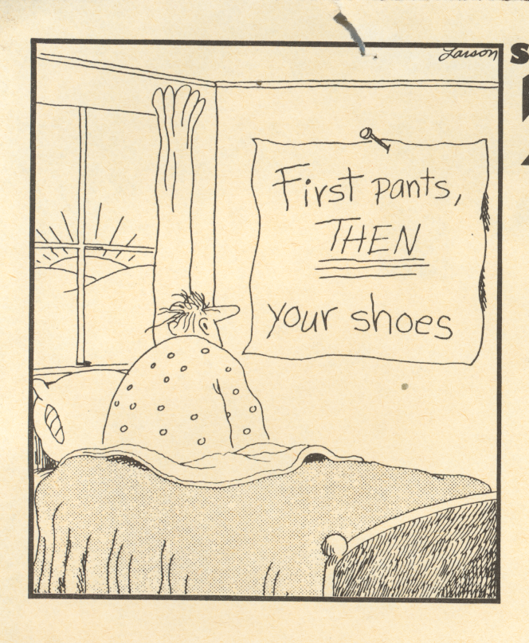

Slide 42
Structured Teaching
Physical structure
  Way child’s physical environment is set up and organized
Visual schedules
  What activities occur and in what sequence
Teaching components
  Work systems (systematic and organized presentation of tasks/materials so child can work without adult directions)
  Visual structure (incorporating visual cues into task/activity
Notes:
Structured Teaching refers to setting up the necessary structures and consistencies in the program to support learning. These include:
Setting up the physical environment in a way that is conducive to learning (having a predictable physical arrangement, an environment that is not overstimulating).
Having a consistent, predictable daily schedule.
Having consistent, predictable routines.
Using a variety of visuals.
While all of these items are important for all children, they are particularly important for children with ASD.

Slide 43
Functional Communication Systems
Give the child an effective and appropriate means to understand what is happening in his environment as well as a way for him to communicate.
Use of a functional communication system often decreases challenging behaviors.
Notes:
Because children with ASD often have challenges in communicating, it is important that they have a way that they can effectively communicate their wants and needs.
Often, challenging behaviors result when children do not have a functional means of communicating.

Slide 44
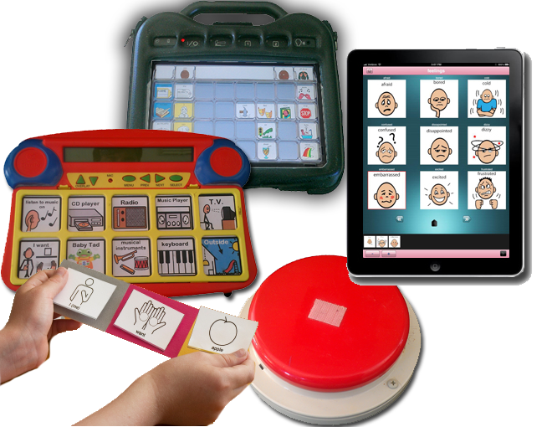
Example
Augmentative/Alternative Communication Devices
Notes:
Augmentative communication devices is one way to assist a child with ASD to communicate their wants and needs.
Your autism specialist or speech language pathologist can work with you to see if this type of device would be useful.

Slide 45
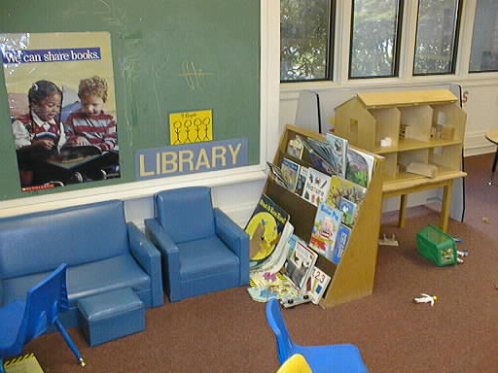
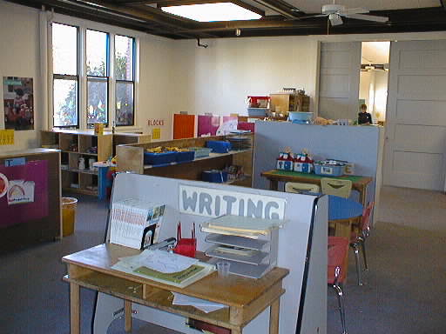
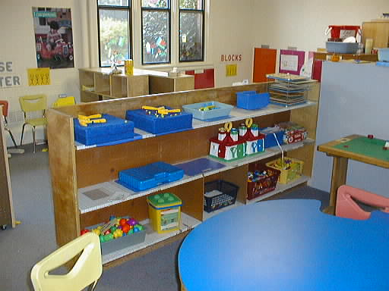
Example
Using visuals to help clarify choices
Library
Writing
Table Toys
Notes:
Visual pictures that show different choices is a useful strategy.

Slide 46
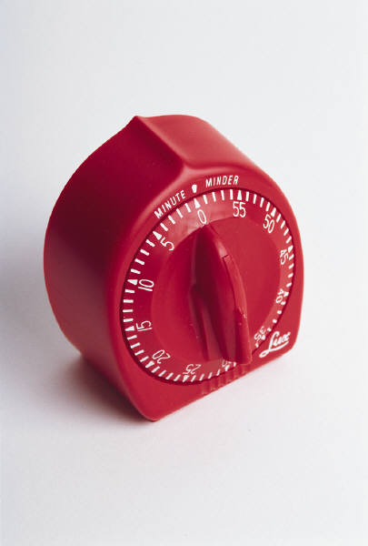
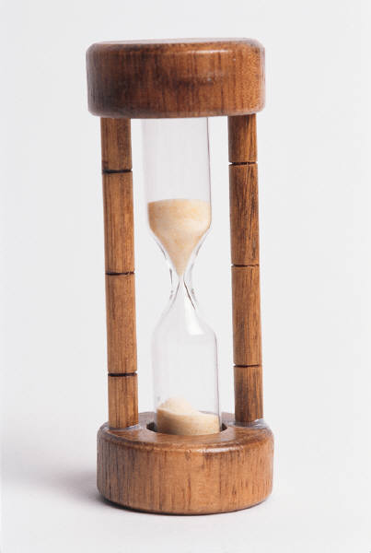
Example
Providing visual prompts
Notes:
The use of visual prompts or props can help the child with ASD more seamlessly transition from one activity to another.

Slide 47
Example
Using visuals for the child to communicate
Notes:
Here is another example of visuals that can help a child with ASD communicate their feelings, wants and needs.
Your autism specialist or speech language pathologist can help you with these types of visuals.
These visuals can also be created using computer software programs such as Boardmaker.

Slide 48

Example
Using visuals to communicate behavior expectations
Notes:
This visual is an example of a card that can be used when a child exhibits an inappropriate behavior and then an acceptable positive alternative behavior.
In this case the inappropriate behavior – hitting and a positive behavior holding their hand.

Slide 49
Example
Providing verbal or visual prompts or warnings
Notes:
These example are visuals to prompt or warn a child about a transition.
In the first example, in 2 minutes it is time to put on you shoes.
The second example is a visual to prompt a child to clean up his toys.

Slide 50
Example
Using a Story Board or Social Story
  Susie is taking a walk with her teacher and the other children.
  Susie runs away from the teacher.
  She must return to the classroom.
  Susie is sad to miss the walk.
  When Susie stays with the teacher, she is happy and sees fun things on the walk.
Notes:
This is an example of a social story.
This social story tell a story of an inappropriate behavior and the consequence and what happens when the child acts appropriately.

Slide 51
Example
Using Scripted Routines
Notes:
A scripted routine is used to break out a common task so that all staff working with a child does the activity in the same way. This structure is particularly important for a child with ASD who needs a predictable routine.

Slide 52
Example
Using Scripted Responses
  When Joey uses inappropriate behavior to get adults attention
    1. Interrupt the behavior. (“Wait” or “Stop, that’s not OK”)
    2. Acknowledge needs or feelings. (“I know you want my attention”)
    3. Give an acceptable alternative behavior. (“But screaming is not okay. If you want my attention you can use your words.”)
    4. Provide assistance to use alternative behavior. (“Say, ‘teacher look’”)
    5. End with mild reinforcement. (“That’s a better way to get my attention”)
Notes:
A scripted response breaks down the response that should be used by all staff when a certain behavior occurs.
Once again, a consistent response from all staff is important.

Slide 53
Video Example
CONNECT Video
University of North Carolina Chapel Hill
Notes:
This is a short video from the CONNECT series of videos produced by the University of North Carolina at Chapel Hill.
This video shows an occupational therapist working with a child with ASD in a preschool program. It shows the use visual supports.
The video lasts about 3 minutes.

Slide 54
Collaborating with Families
Notes:
The final topic that we will be covering during this workshop is collaborating with families who have a child with ASD.

Slide 55
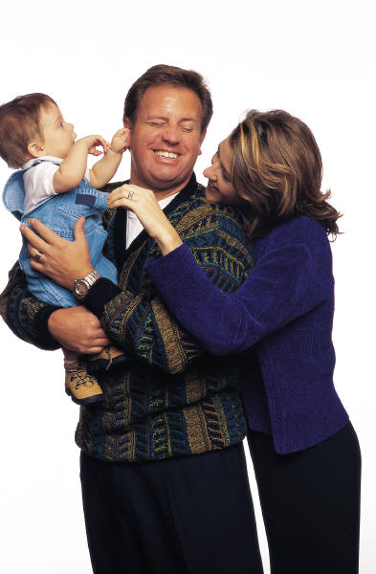
Parent Involvement Philosophy
Parents have the right and responsibility to share in decisions about their child’s care and education.
Notes:
When working with families we believe that parents have the right and responsibility to share in decisions about their child’s care and education. We use this as the basis in working with parents.

Slide 56
Activity
In your small group, identify at least 3 things you can do as a provider to support parents who have a child with ASD.
Record your strategies on the chart paper.
Notes:
Have participants get into a small group of 3-5. Give each group a piece of chart paper and a marker.
Have the groups identify at least 3 things that they can do as a provider to support parents who have a child with ASD.
After the groups are finished, have one person from each group share their strategies with the whole group.

Slide 57
Guidelines for Supporting Parents Who Have Children With ASD
Get to know the family. Build relationship/trust.
Start with where the parents are at.
Take direction from the parents as to how to proceed.
Be sensitive to parents’ struggles.
Be positive. Build on parent and child strengths.
Communicate – keep parents up to date on what is happening.
Notes:
Review the points on the slide.

Slide 58
Guidelines for Supporting Parents Who Have Children With ASD
Listen. Listen. Listen….
Share/be aware of resources.
Help parents connect with other parents if requested.
Don’t use jargon.
Other?
Notes:
Review the points on the slide.

Slide 59
Closing
Notes:
We are going to conclude the workshop with a few closing activities.

Slide 60
Professional Action Activity
Write down and share with a partner at least one strategy or idea you intend to implement from this session.
Notes:
Have the participants complete the Professional Action Activity.

Slide 61
Activity
Line up based on how comfortable you feel working with children with ASD (on a scale of 1-10).
How many changed your position from where you were earlier today?
Notes:
Have the participants line up again like they did for the opening activity.
Have them line up based on how comfortable they feel working with children with ASD (a scale of 1-10).
Ask for volunteers to share whether or not the changed their position from earlier in the training and why.

Slide 62
Workshop Evaluation
Notes:
Have the participants complete the Workshop Evaluation and turn it in.

Slide 63
Thank You!
Notes:
Thank the participants for attending the workshop.

