Slide 1
Improving Local Programs with Outcome Data
DCDT Conference
Portland, Oregon 2015
Pattie Johnson, TRI
Sally Simich, ODE
Charlotte Alverson, NTACT
Notes:
knowledge, strategies, and use of PSO data at different conferences

Slide 2
Objectives
Practical steps for
LEA’s to improve
transition services to all students
Web based multi phase data tool available for LEA’s
In school experiences for post school success - linkages

Slide 3
Transition Services
Transition services offer the final opportunity to strengthen the knowledge and skills a student needs for postsecondary life
Youth have spent 12 years with educators preparing for this launch into adulthood
How successful are they going to be?
What can be done to improve that success?

Slide 4
Oregon’s Data On The Four Transition Indicators
Notes:
Preliminary 2015 follow up interview results PSO
2014 2015
Response rate 79% 78%
Engagement rate 70% 71%
Higher Ed 24% 23%
Competitive Employ 30% 34%
Other school/work 16% 15%
NOT ENGAGED 30% 29%

Slide 5
Students who leave with a regular diploma are better prepared for additional training or schooling
Students who leave without a regular diploma lack skills and knowledge they need to be successfully engaged in school or work
One year after leaving school, 30% of Oregon students have not worked or been in school for at least 3 of the 12 months
What we know:

Slide 6
Oregon, like many states, is moving from sample to census for Post School Outcomes collection: LEA’s are required to interview all students this coming year
LEA’s are strongly encouraged to educate students and families about the PSO collection. Student experiences after leaving matter to districts working to improve transition services
ODE will provide technical assistance to LEA’s to use data from the PSO reports and STEPSS tool
Change:
Notes:
HANDOUT
Mention that we’ll talk about STEPSS later

Slide 7
Improving local programs with outcome data -- Where to start?
Gather the most recent results:
Post school outcomes
Graduation rate
Dropout rate
Compliance on the IEP transition standards
Notes:
Using all four indicators

Slide 8
Gather information on performance, programs, services, staffing, and other transition related items.
Assemble a team of stakeholders to discuss the findings, including data savvy representative.
Organize the data using a table, graph of data of description of the results.
Use a process to walk through what you find.
What does the LEA do?

Slide 9
Example of table organizing results:
Most current district data | District | District (state)Trends | State
Graduation Rate (4 year) | 46% | Decrease 2% (state increase 14%)¹ | 51%
Graduation Rate (5 year) | 52% | Increase 2% (state increase 12%)¹ | 56%
Dropout Rate | 5% | No change (state no change%) | 6%
Students with quality IEP’s as measured by compliance on all 8 transition standards | 90% | No change (state dropped 7%) | 75%
Students in post-secondary school 1 year out | 25% | No change (state no change) | 24%
Students competitively employed one year out + in post-secondary school 1 year out | 56% | Increase 1% (state decrease .5%) | 54%
Total engagement | 74% | Increased 2% (state no change) | 70%
Notes:
Pattie
Handout

Slide 10
Example: Questions to Ask
Are students leaving in 4 or 5 years with a diploma?
Is the dropout rate going up? Going down?
Have more than a third of our leavers completed NO work or training after leaving school?
How do in-school services differ for students who successfully transition to work or school and for those students who are not engaged within a year?
Can we demonstrate that transition aged youth have IEP’s that are strong and include quality services?

Slide 11
Highlight the performances that stands out —either because they show positive outcomes, or show areas to improve
Compare district results to state results—look for patterns
What changes took place that might have influenced results such as
change in the program
district activities
staffing
What do the data show…

Slide 12
Discuss the areas to examine more closely
For PSO results, do particular subgroups show noticeable differences?
Request additional data results showing subgroup performance
Graduation
Dropout
Transition standards.
Prioritize district needs and begin a
strategy to improve results
Continue the process:
Notes:
This is where STEPSS can help

Slide 13
Overarching Question for Schools
and Stakeholder Groups
What can our organization do to increase the likelihood of youth being engaged after leaving school (i.e., obtaining competitive employment or higher education)?

Slide 14
Start with what you know is the best available evidence
Positive Post-School Outcomes
In-School Predictors of Post-School Success
Evidence-Based Practices
School, District, & State Level
Student Level
Notes:
Charlotte takes over Handout of predictors

Slide 15
Predictors of Post-School Success
A predictor is defined as an in-school experience, typically a program (e.g., a work-based learning experience) correlated with improved post-school outcomes.
Notes:
Materials:
www.nsttac.org
Description of EBPs and Predictors of Post-School Success handout
Facilitators notes:
Predictors of post-school success are derived from research and include any in-school experience that have demonstrated a relationship with positive post-school outcomes. In-school experiences are typically programs such as work study or occupational coursework but also include other instruction, services, or student characteristics such as student support, student self-determination skills, etc.

Slide 16
What are evidence-based practices?
a teaching method, shown to be effective based on high-quality research, for teaching a specific skill
(Cook, Tankersly, & Landrum, 2009; Odom, Brantlinger, Gersten, Horner, Thompson, & Harris, 2005).

Slide 17
Evidence-Based Practices
Research-Based Practices
Promising Practices
Un- established Practices
Have demonstrated a record of success for improving student outcomes
Have used rigorous research designs
Have undergone systematic review process quality indicators to evaluate level of evidence
Have used rigorous research designs
Have demonstrated a record of success for improving student outcomes
Developed based on research
Have demonstrated limited success for effectiveness
Have used a ‘weak’ research design
Are not based on research
No data have been collected
Based on Anecdotal evidence and professional judgment exists
(Helsel, Hitchcock, Miller, Malinow, & Murray, 2006; Lembke & Stormont, 2005; Twyman & Sota, 2008)
Notes:
Evidence-Based Practices
Have used rigorous research designs
Have demonstrated a record of success for improving student outcomes
Have undergone systematic review process quality indicators to evaluate level of evidence
Research-Based Practices
Have used rigorous research designs
Have demonstrated a record of success for improving student outcomes
Promising Practices
Developed based on research
Have demonstrated limited success for effectiveness
Have used a ‘weak’ research design
Unestablished Practices
Are not based on research
No data have been collected
Based on Anecdotal evidence and professional judgment exists

Slide 18
How do you connect post-school outcomes of youth with disabilities to practices implemented in the classroom?

Slide 19
A Closer Look: Mnemonics
A word, sentence, or picture device or technique for improving memory.
Improved academic performance in school
Helps students use what they know to learn new information
Used in spelling, math, science, English, music
Effect Size: 1.38 across the research studies
Purpose: enhanced memory
Students: specific learning disabilities, intellectual impairment, emotional-behavior disabilities
Three types of mnemonics:
Letter
Keyword
Pegwords

Slide 20
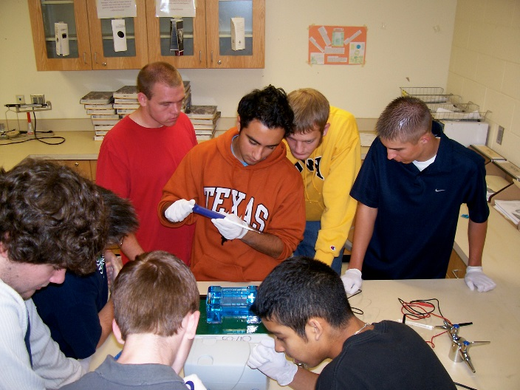
How do evidence-based practices apply to transition planning and instruction?
Evidence-based practices increase the likelihood of students learning specific skills
Used to support:
IEP goals and objectives
Skill development
Individual students’ success

Slide 21
Examine 4 years of graduation, dropout, secondary transition components of the IEP, and post-school outcomes data;
Assess progress toward meeting targets in each outcome area listed above;
Select predictors of post-school success to focus efforts, and
Develop and implement an action plan designed to improve in-school, secondary transition programs for students with disabilities.
STEPSS helps state and local education agencies use secondary transition data in a continuous improvement process. It is a web-based, multi-phase process, enabling stakeholders to:

Slide 22
Oregon’s commitment to supporting LEA’s
Track in-school work experiences
Measure agency involvement before and after leaving
Partner with other Oregon agencies at state and local levels
Joint training opportunities with other agencies
Transition Technical Assistance Network
Notes:
Data from Exit on in school experiences
Who do you plan to get help from…. Do you know the name….. Have you used services
Get dat

Slide 23
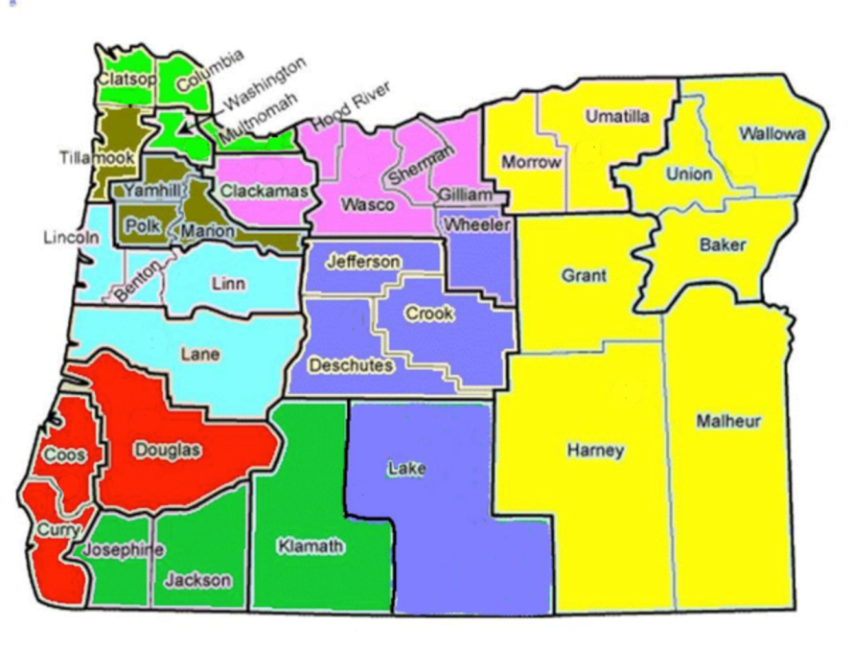
Transition Technical
Assistance Network
State coordinator
8 regional full-time Transition Network Facilitators (TNF) around Oregon
1 Regional Training and Business Development Coordinator
Cooperatively funded through Oregon Vocational Rehabilitation Services and Oregon Department of Education

Slide 24
TNF Network
Goals for the 2015-2016 year
Offer technical assistance to educators for students with disabilities who are of transition age.
Develop strategies for successful team facilitation and planning.
Continue to develop relationships with community partners such as Vocational Rehabilitation, Developmental Disabilities Service, County Mental Health, family advocacy programs, etc.
Implement training and professional development for regional partners on policy and systems change.
Provide support to districts in understanding Pre-Employment Transition Services (PETS).
36

Slide 25
Transition Technical Assistance Network Regional Programs

Slide 26
Questions?

Slide 27
Pattie Johnson
The Research Institute at Western Oregon University
johnsop@wou.edu 503-838-8779
Sally Simich
Office of Learning - Student Services, Oregon Department
of Education sally.simich@state.or.us 503-947-5639
Charlotte Y. Alverson
National Technical Assistance Center on Transition, University of Oregon calverso@uoregon.edu 541-346-1390
For more information:

